Slide 1
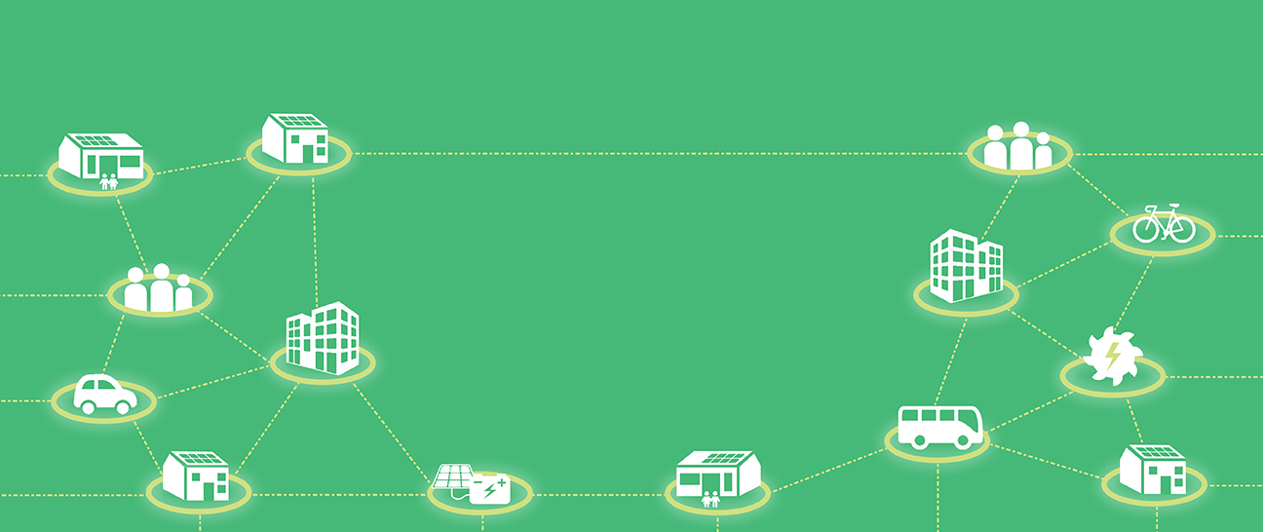

CREATING ENERGY WE CAN ALL FEEL GOOD ABOUT
www.lowcarbonhub.org
Low Carbon Hub IPS AGM
CREATING ENERGY WE CAN ALL FEEL GOOD ABOUT
Monday, 2 October 2023, 6:30pm

Slide 2
CREATING ENERGY WE CAN ALL FEEL GOOD ABOUT
www.lowcarbonhub.org
CREATING ENERGY WE CAN ALL FEEL GOOD ABOUT
Welcome!

Slide 3

AGENDA
Time | Section | Speaker
18:30 | Introductions, attendance & apologies | Steve Drummond
18:40 | Renewables Portfolio - Generation review | Tim Jones
18:48 | Smart Energy Systems – understanding the challenge | Mairi Brookes
18:55 | Communities in Action | Al Kitchen
19:01 | Treasurer’s Report and Q&A | Luke Marion
19:15 | Looking Forward What does the Hub to help catalyse a sustainable future? How do we make the Hub match-fit for delivering the vision? | Barbara Hammond & Steve Drummond
19:35 | Q&A | Steve Drummond
19:45 | Formal AGM Resolutions | Steve Drummond
19:55 | Closing remarks | Barbara Hammond
20:00 | Meeting close
Notes:
Welcome address: cover main housekeeping bits inc. keep muted, ask questions in chat, vote live using Zoom poll,

Slide 4
CREATING ENERGY WE CAN ALL FEEL GOOD ABOUT
www.lowcarbonhub.org
CREATING ENERGY WE CAN ALL FEEL GOOD ABOUT
Renewables Portfolio - Generation Review
Tim Jones, Renewables Portfolio Director

Slide 5

Health and Safety 2022-23
2022-23
0
0
0
0
0
0
23
11
1
0
Deaths due to conditions or events taking place under the responsibility of the Low Carbon Hub.
Injuries resulting in more than 3 days off work.
Injuries that were recorded but resulted in 3 or less days off work.
Incidents that involved significant confrontation including physical or emotional abuse.
RIDDOR reports detail work-related accidents that result in reportable injuries.
Near miss: an unplanned event that did not result in injury, illness or damage, but had the potential to do so.
Documented inspections by employees or external companies.
Notices as the result of inspections or new legislation that require alteration of H&S practices.
An informal group discussion that focuses on a particular safety issue.
Training courses/instruction from a qualified professional/institution related to health & safety practices.
Fatalities
A)
Lost Time Injury
B)
Injury Incidents
C)
Conflict Incidents
D)
RIDDOR Reports to HSE
E)
Near Miss Reports
F)
Workplace and Activity Inspections
G)
Safety Improvement Notices
H)
Toolbox Talk Attendance
I)
Formal Learning Events
J)

Slide 6
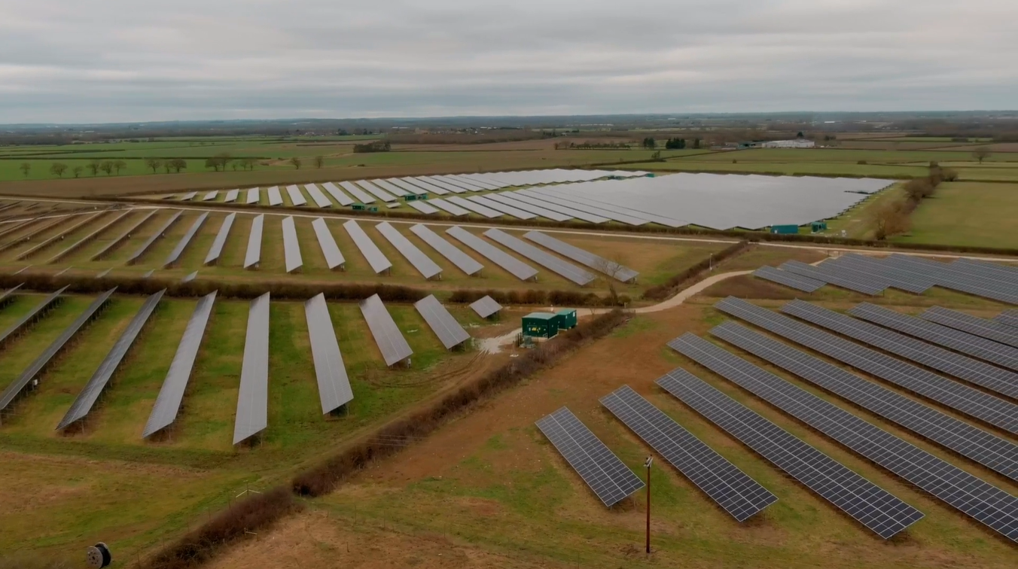
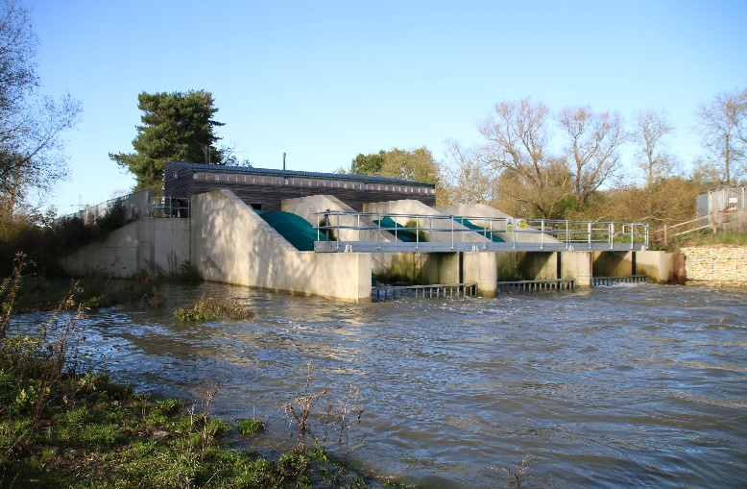
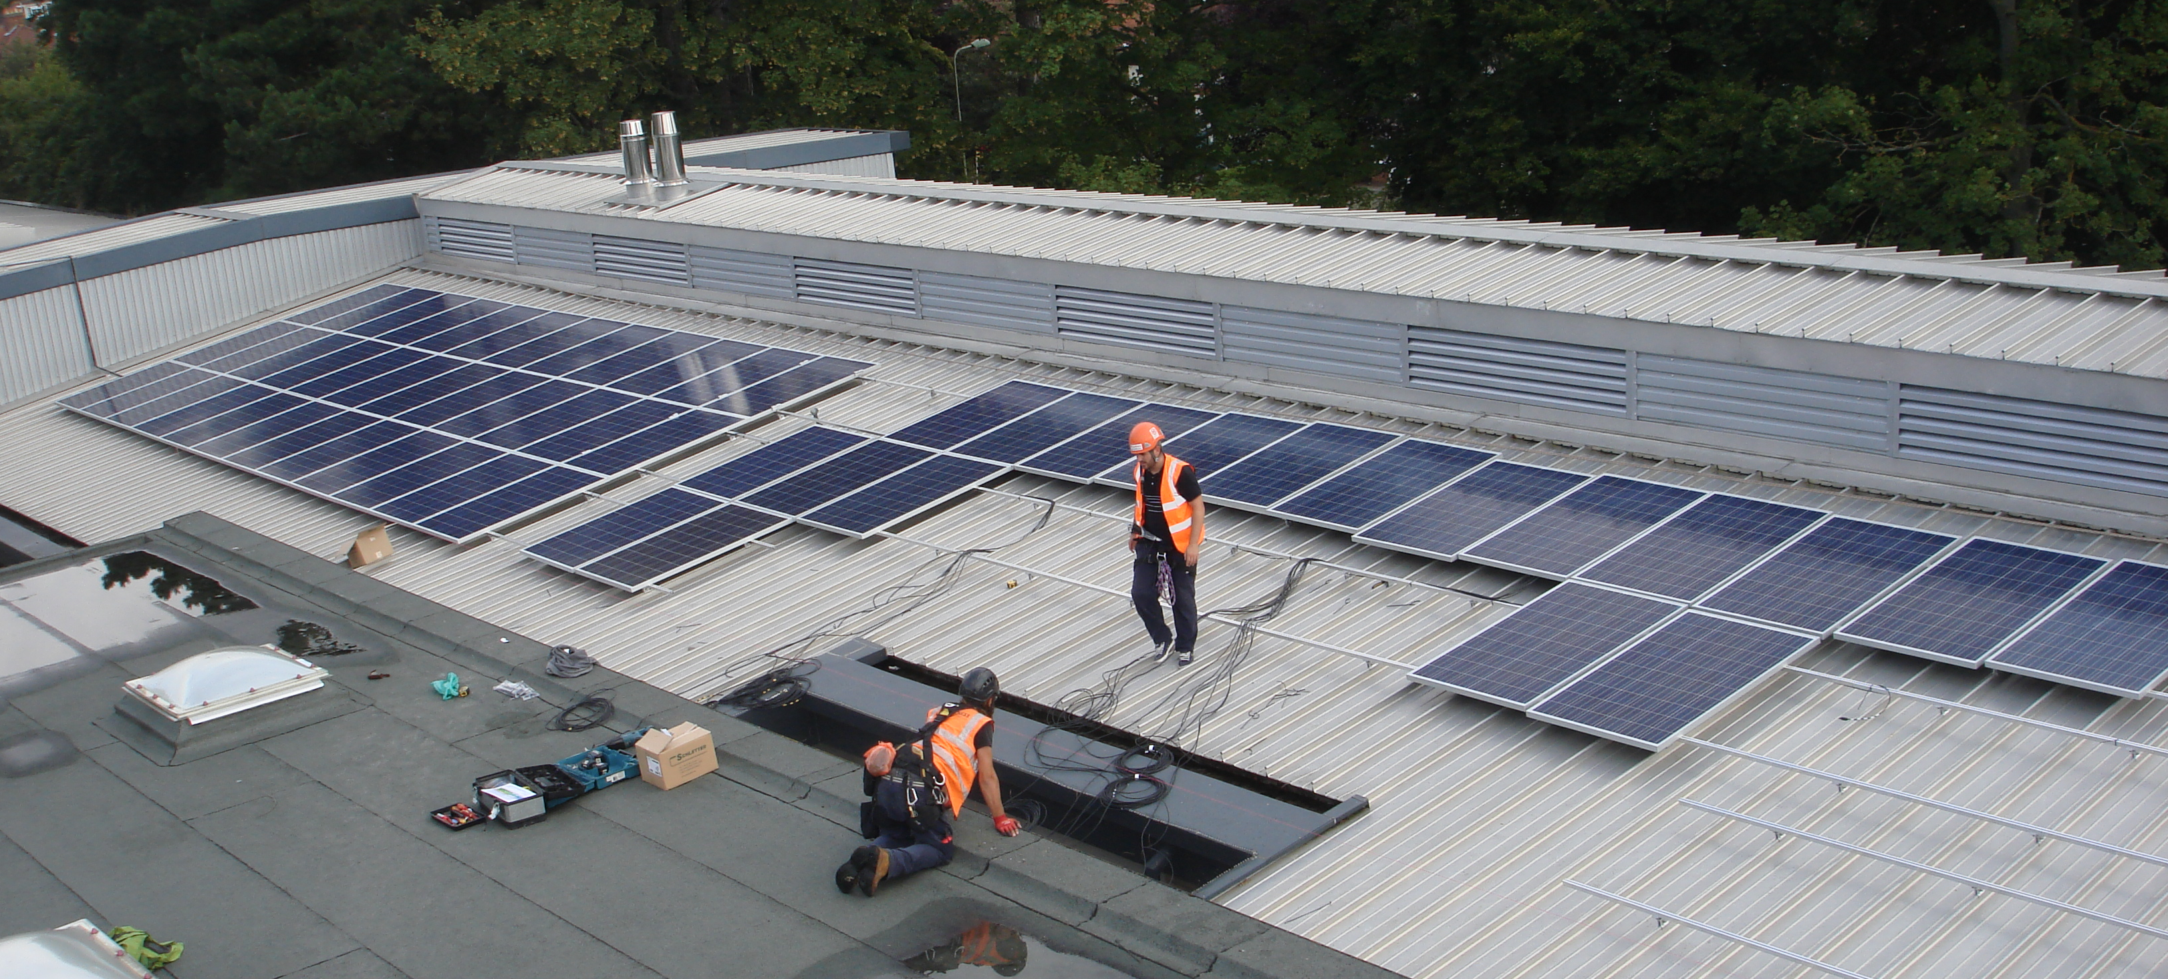
Generation Assets
1) Ray Valley Solar 2) Sandford Hydro
3) Roof Top Portfolio

Slide 7
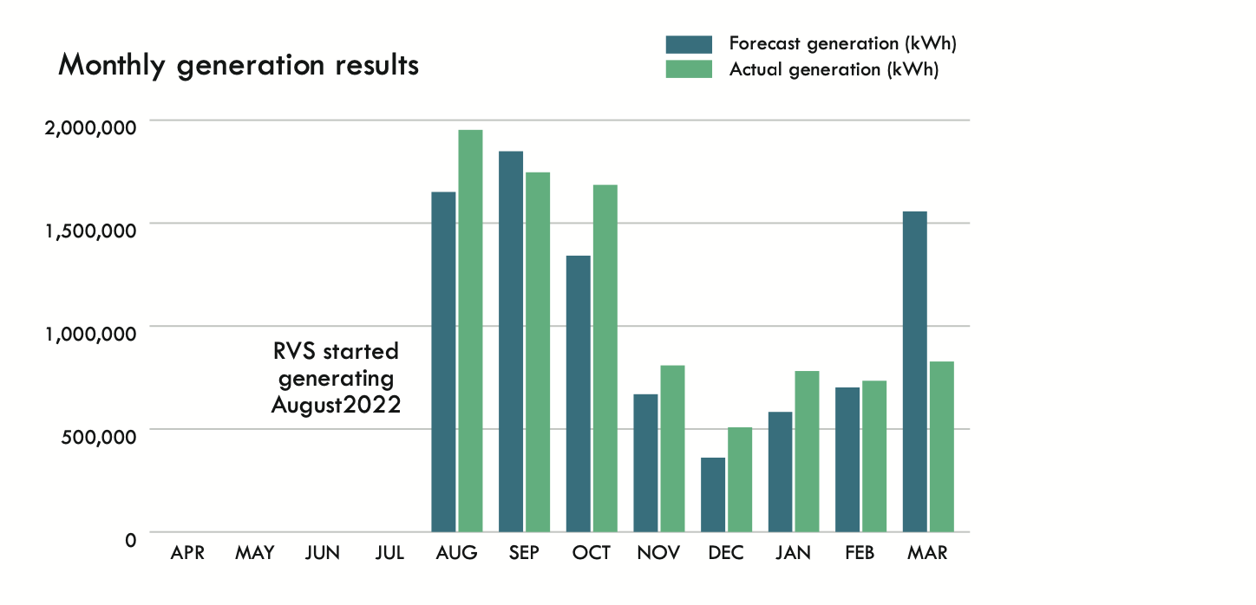
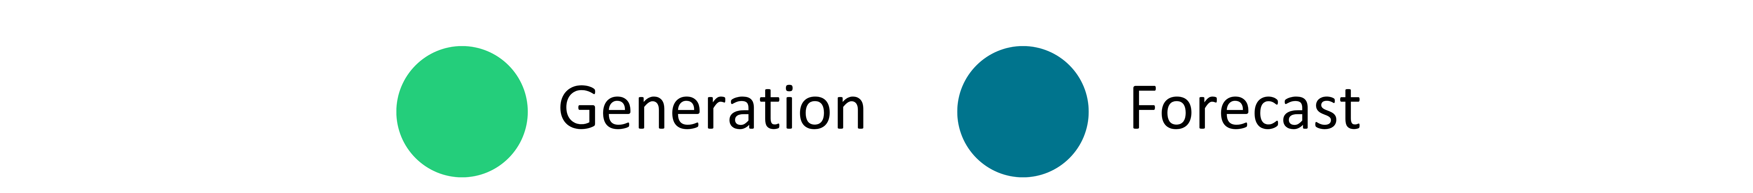
Ray Valley Solar (RVS)
RVS produced 9,046 MWh last financial year.
Production lower than target due to plant switch-offs in 2022 and subsequent transformer replacements in 2023.
During full operation, RVS has significantly outperformed achieving 3% above forecast generation, despite being partially shut down in March for transformer replacement.

Slide 8
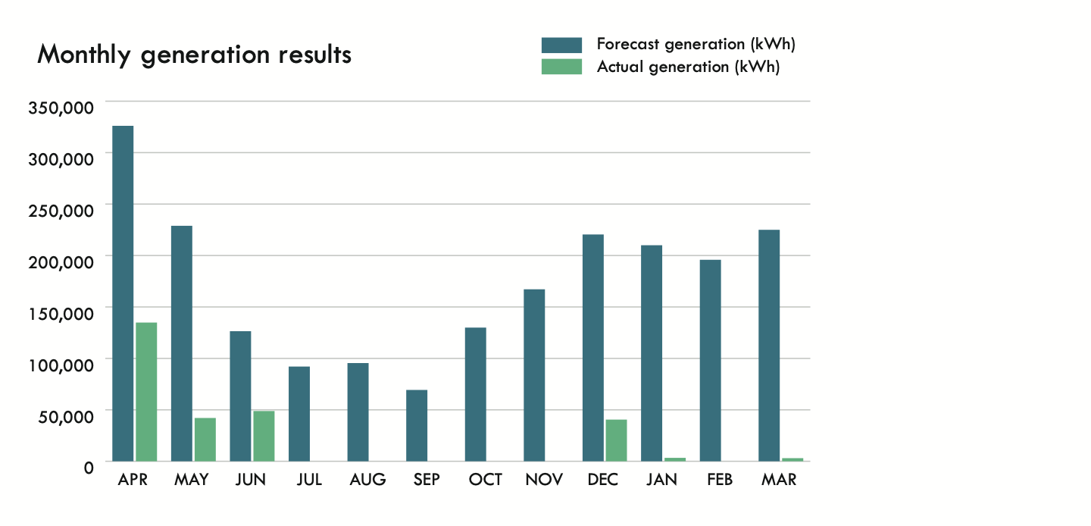
Sandford Hydro
  Sandford Hydro performed poorly last year.
  A programme of upgrades has begun.

Slide 9
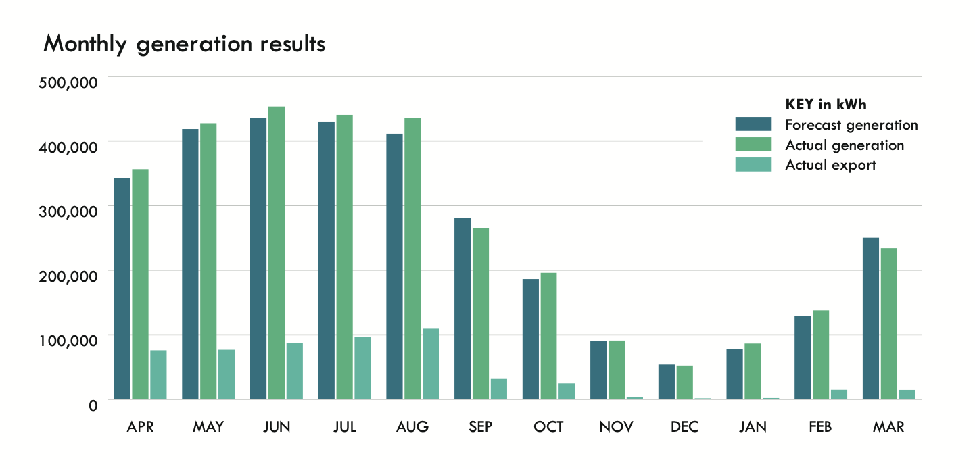
Roof Top Portfolio
Portfolio produced 3.18 MWh 2% above target.
Inverter replacement programme to upgrade kit
Two new arrays commissioned plus two more near completion at year end.

Slide 10
RVS Future Generation Outlook
Uplifted vs. Baseline forecast
RVS is now 100% operational and expected to generate 18.5 MWh per annum.
Secure habitat for Protected Great Crested Newts has been established as an integral part of the development.
MWh
Uplifted forecast
Baseline forecast

Slide 11

Sandford Future Generation
2023/24 Uplifted vs. Baseline forecast
With full operations restored, and upgrades, Sandford has the potential for improved generation in the coming year.
MWh

Slide 12
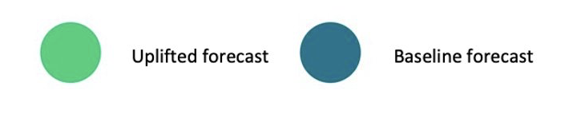
Roof Top Future Generation Outlook
2023/24 Uplifted vs. Baseline forecast
With the installation of phase 3 at Norbar Tools the annual predicted generation for our roof top portfolio will exceed 3.4 GWh.

Slide 13
Generation Conclusions
The coming year offers strong generation growth through:
Ray Valley Solar farm will be fully operational.
Sandford Hydro will be back to 100% operational with increased generation capacity.
Roof top PV portfolio will continue to grow.

Slide 14
Smart Energy Systems – understanding the challenge
Mairi Brookes, Smart Energy Systems Director

Slide 15
Understanding the challenge
To meet the UK’s carbon targets, we need an energy system primarily supplied by renewable electricity.
Heat and transport will need to transition, largely to heat pumps and electric vehicles.
This enormous change will happen right at the grid edge where the electricity system meets each household and each business.
It requires a doubling of electricity supply: but each household and business will be using half the total energy.*
*Centre for Research into Energy Demand Solutions
Notes:
When the Hub started up our focus was to get more renewable generation.
It was about saying: we want clean energy and if you (the sector and the politicians) won't deliver it, we will!
The challenge has moved on.
We still need a system powered by renewables. But just adding more generation isn't enough.
Heat and Transport need to transition to heat pumps and electric vehicles.
That huge change will happen at the edge of the grid.
Even though switching away from fossil fuels will reduce the total amount of energy needed, this change implies a huge increase in the amount of energy in the form of electricity required.
So to make this happen we not only need to enable communities to adopt these new technologies, we need to address the fact that our electricity network isn't set up to support this yet.
That is for two reasons:
1) our system still assumes the majority of generation isn't going to be located at the grid edge;
and 2) because the cables aren't big enough to bring the electricity, that we need, in from elsewhere.
The solution doesn't have to just be about spending lots of money to upgrade the wires. Technology can allow us to coordinate local generation, storage and use of electricity at the grid edge.
Making that happen has the potential to
accelerate how fast we decarbonise;
enable us to do so in time to meet climate targets,
and all with the possibility that we can keep the benefits local, and deliver a fairer energy system.
This is the challenge that our Smart Energy Systems innovation programme is trying to find solutions for.

Slide 16






Project LEO: A toolkit for net zero
Flexibility market development
Investable business models
Skilled community of people
Trialling flexibility
Mapping for Local Area Energy Plans
Notes:
A big part of our journey has be Project LEO – a four year project led by SSEN and which Low Carbon Hub was at the heart of.
At the heart of LEO was the desire to work out how turning generation and demand for electricity up or down could help our local network operator to keep the lights on when, for example, they were forecasting that evening demand would overload a substation.
This is an increasing challenge for them as the amount of renewables increases, making it harder to forecast need far enough in advance to plan and deliver upgrades to substations.
Many of you will have experience of flexibility services from last winter when it was possible to be rewarded by your Supplier or an organisation like Equiwatt for reducing your energy when asked to do so. The services we were testing were like this, but instead of addressing national network management challenges, they focused on local network challenges.
We wanted to test whether the income from delivering those "flexibility services" could make more renewable generation viable – which we did with our own portfolio of assets
And we wanted to find out how these kinds of services might play a part in helping communities meet their energy needs in a clean, affordable and fair way.
We did that through six Smart and Fair Neighbourhood projects with some of our community shareholders.

Slide 17
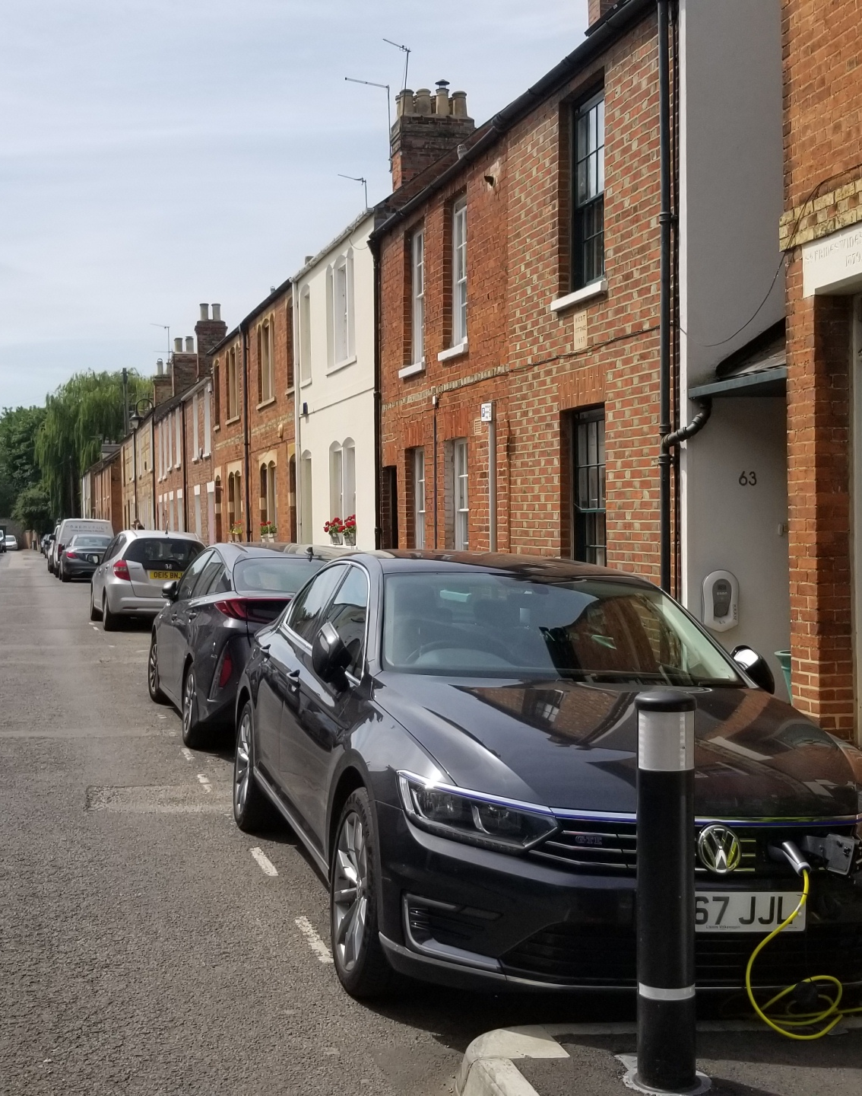

Lessons from LEO
Talking about "smart energy systems" is hard – it needs translation
"Local" depends on the nature of the challenge
A "grid edge coordinator" is needed to translate Local Area Energy Plans into action on the ground.
Local flexibility services don't currently make community renewables more viable
Smart Community Energy Schemes could create value for everyone
Notes:
I can't go through everything that we learned in these four years, but I'd like to give a flavour of why it was a success, what we've learned and how that is shaping our work going forwards.
We learned how to talk about flexibility much better. It was really hard to engage our trial, Smart and Fair Neighbourhood communities at the beginning, but by the end they were better than us at describing what it means.
Actively managing generation flexibly has high transaction costs at the moment, without significant automation delivery of these services to the network operator they don't improve the investment case for community-scale renewables
When we started working with our Smart and Fair communities, we looked at different ways to define what we meant by local – community-based, geographical, democratic as well as energy system. Our experience in Eynsham is that a primary substation area is a good starting point for planning for local decarbonisation.
In each of our Smart and Fair projects, a role emerged for Low Carbon Hub that we are calling "grid edge coordinator": to develop ideas for decarbonisation projects through the early stages of feasibility and towards a business case, it takes a commercially-minded, nimble organisation that is free to explore ideas with the people and organisations who might eventually deliver, own and/or operate those projects. The role goes beyond what the network operator and local government can typically do – either because of regulation or capacity; but it relies heavily upon working with them and translating their planning responsibilities into action.
A key output of Project LEO is the concept of a Smart Community Energy Scheme.
Put at a very high level: it is a service that enables participants to coordinate their generation, consumption and storage of energy. Participants could be households, businesses and operators of community energy generation projects.
This project would not have happen without LCH – our generation assets and our battery were the basis for most of the early trials – and so our profile and ability to influence policy development has increased accordingly

Slide 18


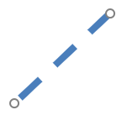




What is next?
The challenge is the decarbonisation at the grid edge.
To achieve this our buildings must significantly reduce their carbon emissions by retrofitting …
… and by what we call "future-fitting".
Scale up retrofit / Develop FutureFit
Optimise energy use within buildings
"FutureFit" buildings can participate in Smart Community Energy Schemes.
What are real-world examples of a Smart Community Energy Scheme?
Net Zero Energy System
Notes:
Think about: Look at grid edge video – simplify, think about benefits and what it might mean for people – and FOx/LEO-N would enable us to continue the work with strong collaborative partnerships we've already built

Slide 19
CREATING ENERGY WE CAN ALL FEEL GOOD ABOUT
www.lowcarbonhub.org
CREATING ENERGY WE CAN ALL FEEL GOOD ABOUT
Communities in action
Al Kitchen, Communities Director

Slide 20

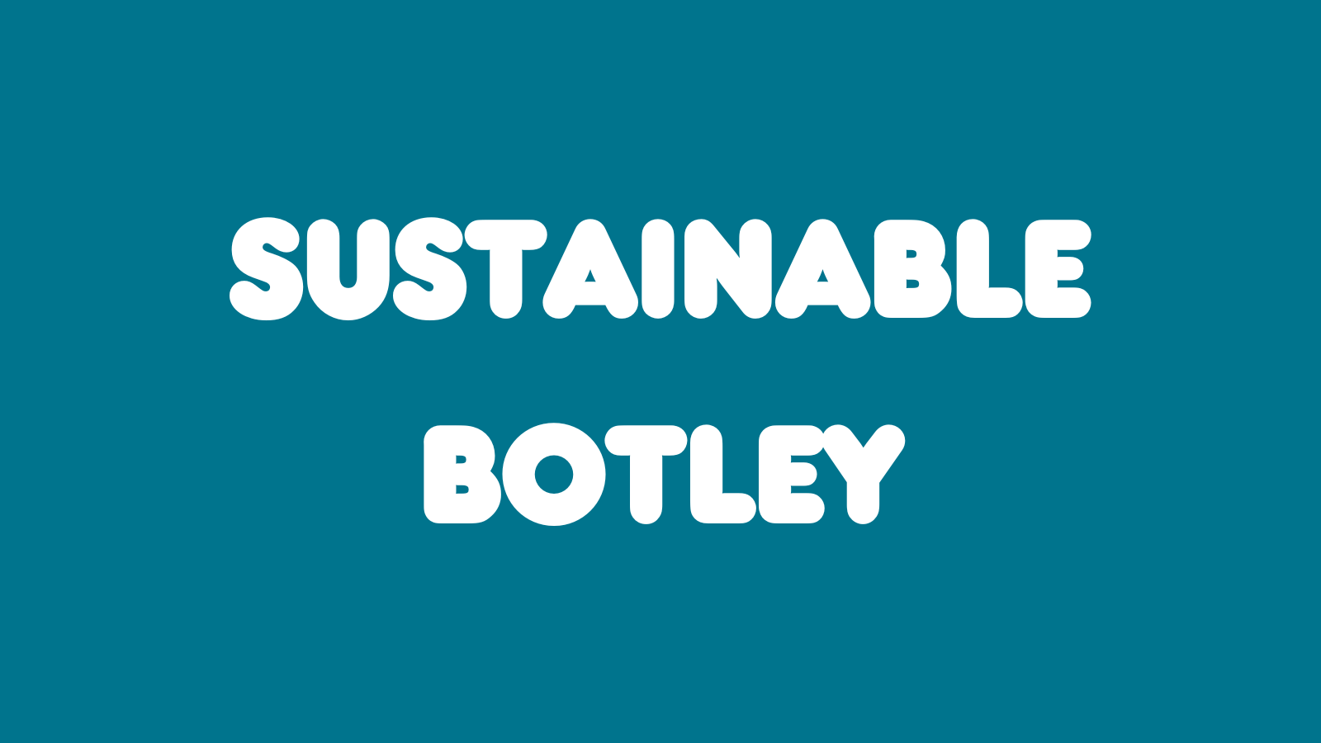


We welcomed three new groups in 2022/23…
41 Low Carbon Community groups are now in our network
Notes:
Our network of low carbon community groups continued to grow – we welcomed three new groups to Low Carbon Hub – bringing the total to 41.
Historically, the groups in our network held a £1 share in the Low Carbon Hub CIC.
As part of the CIC and IPS consolidation we invited all the community groups who held a share in the CIC to exchange it for a share in the IPS – so today is the first IPS AGM where community groups have voting rights during the IPS AGM.

Slide 21
Multiplying community benefit
Our renewable generation portfolio financial surpluses leverages additional grants and funding to support community-led activity.
Our multiplier effect
  Creates a double carbon cut
  Catalyses the transition to a zero-carbon carbon energy system
£35,117
£4,215,280
Surpluses donated
Community benefit delivered
Notes:
The Low Carbon Hub is built around a ‘double carbon cut’ model . The renewables we own and manage create green electricity (carbon cut number one) – and a sustainable income stream to support further community action on climate change (the second carbon cut.)
The income is further bolstered by a number of different income streams:
-- donations from organisations such as Westmill Solar
-- Income from the two CIC-owned installations (Eynsham)
-- Additional grants and contracts such as the ERDF-funding to support the OxFutures partnership and Innovate UK grant funding for Project LEO.
Together, these additional sources of income significantly increase the funding available for community benefit – and the scale of the activity we can deliver.

Slide 22







Delivering action across Oxfordshire
Community Grants Programme
Helpdesk
Notes:
This funding enabled us to deliver a wider range of programmes:
Grants programmes supporting the work of Local low Carbon Groups
Our helpdesk offers support and advice
We’ve worked in partnership with local experts to support energy efficiency for homes, schools, organisations and business es
And of course, innovation at the grid edge, through Project LEO which Mairi has already told us about
The Low carbon hub’s community group network play a crucial part in the success of these activities – and I now want to focus on three areas that show just how key these groups are to our work.

Slide 23
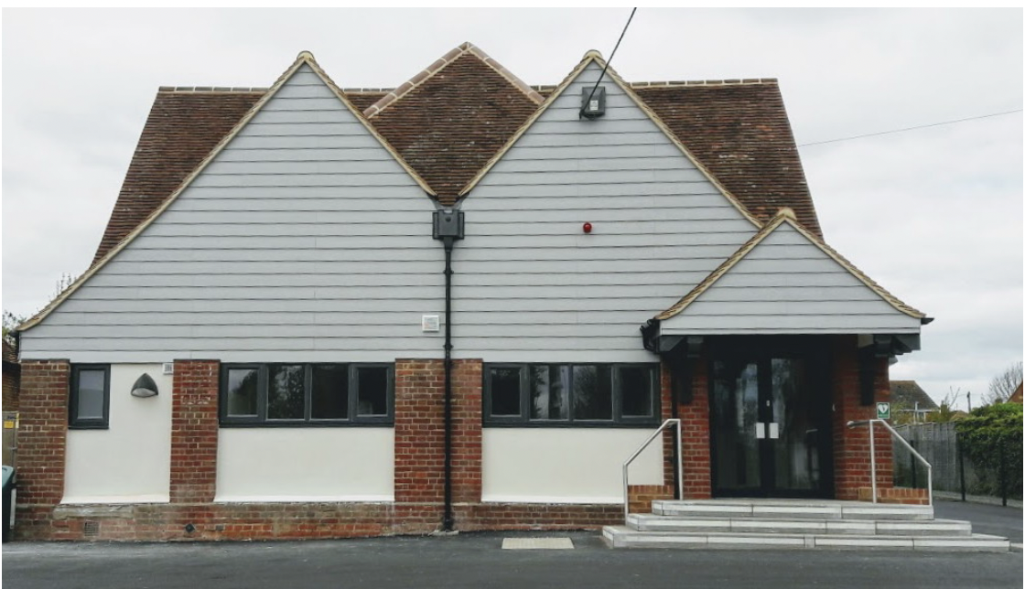
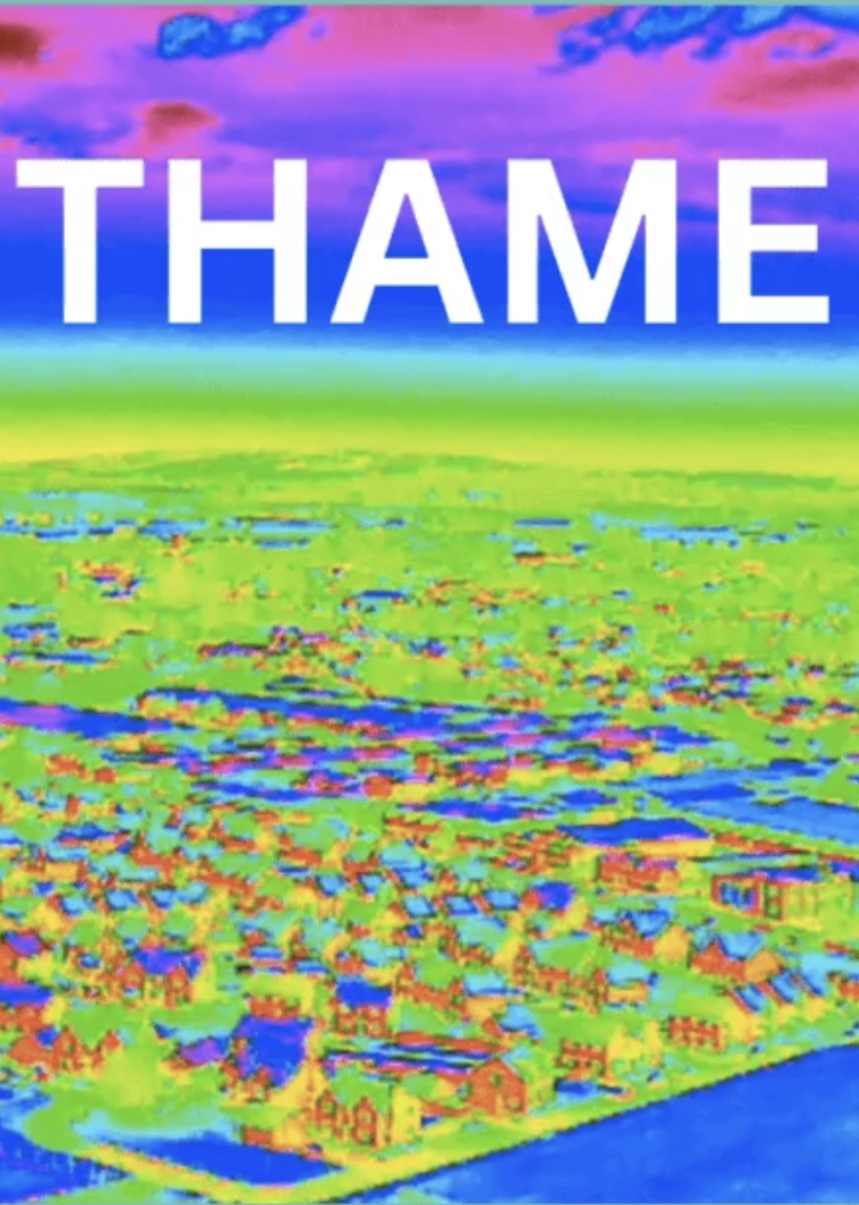
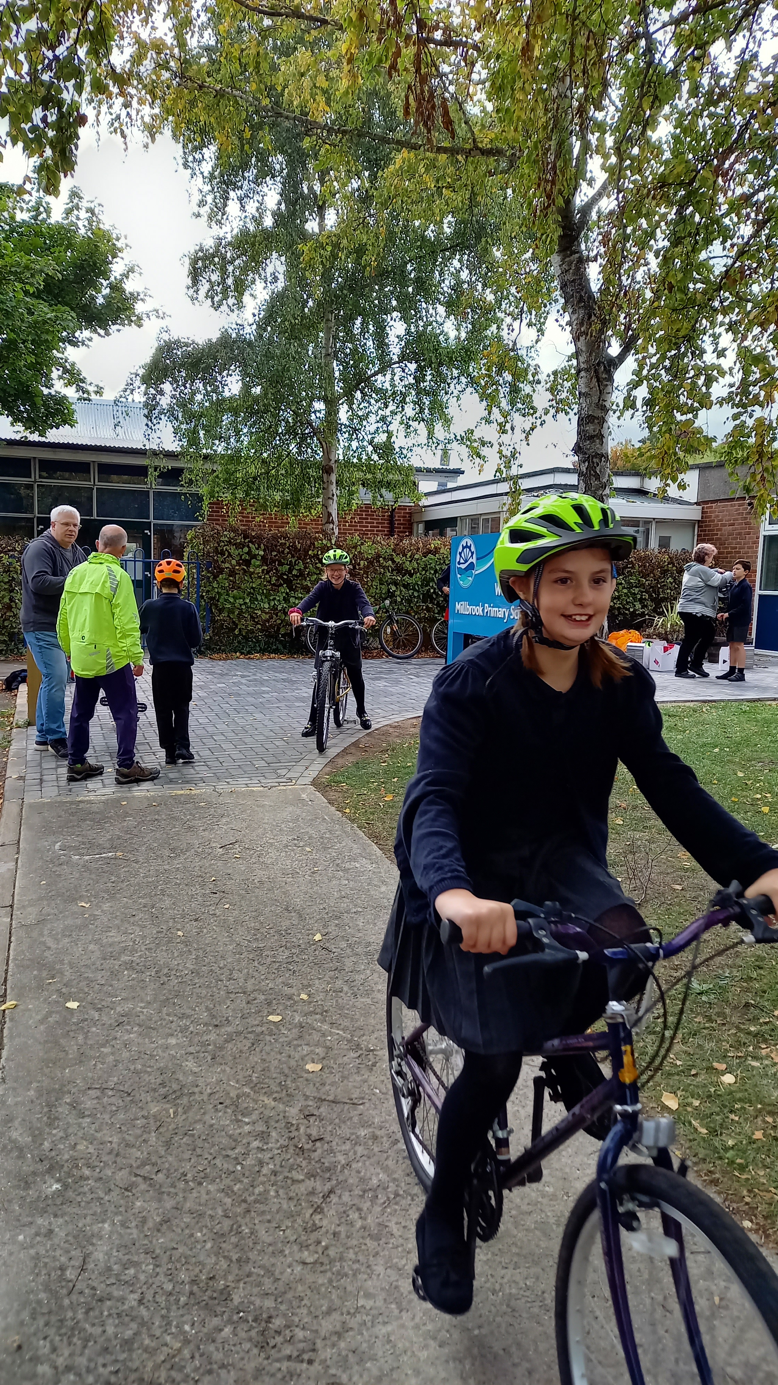


Our community grants programme
Notes:
First:
Our community grants programme has supported carbon-cutting grassroots activities of groups across the county. The 9 grants we awarded this year grants supported low carbon transport solutions including the installation of an EV charging point at a community centre, a community e-cargo bike scheme, and promoting active travel to school. We also funded a range of energy efficiency activities, supporting thermal imaging in Thame, Draughtbusting in Wantage and the Oxford wide Energy Savings Home initiative.
Bit more detail on grants as background:
Large Grants Programme £22,296
£5000 Low Carbon Oxford North and Communities for Zero Carbon Oxford for Energy
Saving Homes 2023
£5000 Low Carbon West Oxford for Electric Cargo Bike Hire in West Oxford
£5000 Sustainable Harwell for the Installation of Solar PV & Batteries at Harwell Village
Hall & The Harwellian Sports & Social Club
£4541 Sustainable Wantage for Strategic Promotion of Active Travel in Wantage
£2774 Thame Green Living for Cosy Thame Thermal Imaging Project
Small Grants Programme £2,000
£500 Low Carbon Marston toward community outreach and energy advice
£500 Low Carbon Oxford North towards promoting active and safe routs to school, to
reduce car traffic
£500 Sustainable Kirtlington towards the installation of an EV charging point at the
village hall
£500 Sustainable Wantage towards tools and equipment to support their
draughtbusting service

Slide 24
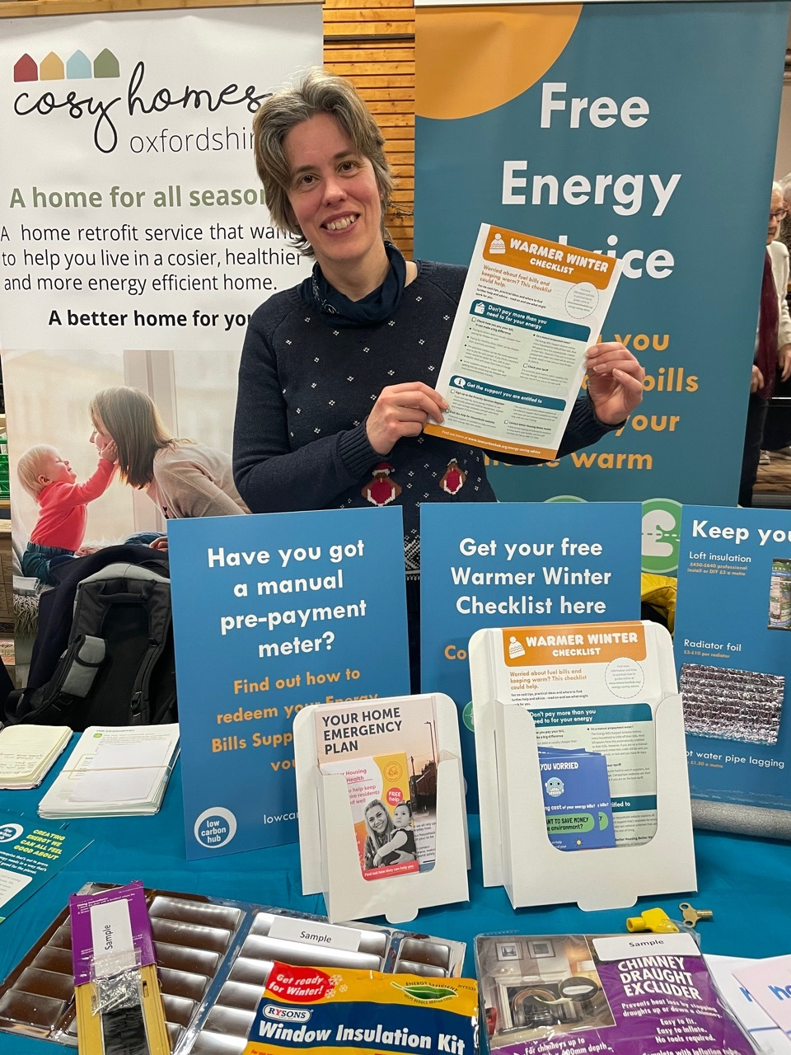
Energy Advice Programme
Notes:
A new programme for 2022/23 was our Energy Advice Programme which was set up in response to the energy crisis. The scheme provides volunteer energy champions from Oxfordshire Low Carbon Community Groups with an ‘energy advice stall in a box’ plus training to enable them to offer energy advice within their communities.
In total we trained Energy champions from 14 community groups. Between them they had almost 800 conversations with householders looking for wide ranging energy advice, and attended 90 community event.
The Energy Advice Stall in a box contains:
A pop-up banner.
Energy advice reference folder and housewarming guides.
Displays stands with insulation samples.
Other draught-busting samples including:
· Letterbox draught excluder
· Window clingfilm insulation
· Cloth draught excluder
· Radiator foil
Other example materials such as a meter key, radiator key, and room thermometer.
Giveaways for people to try at home.
The warmer winter checklist.
A range of leaflets on topics such as grants and local services
A tablecloth, clipboard, and a pen.

Slide 25
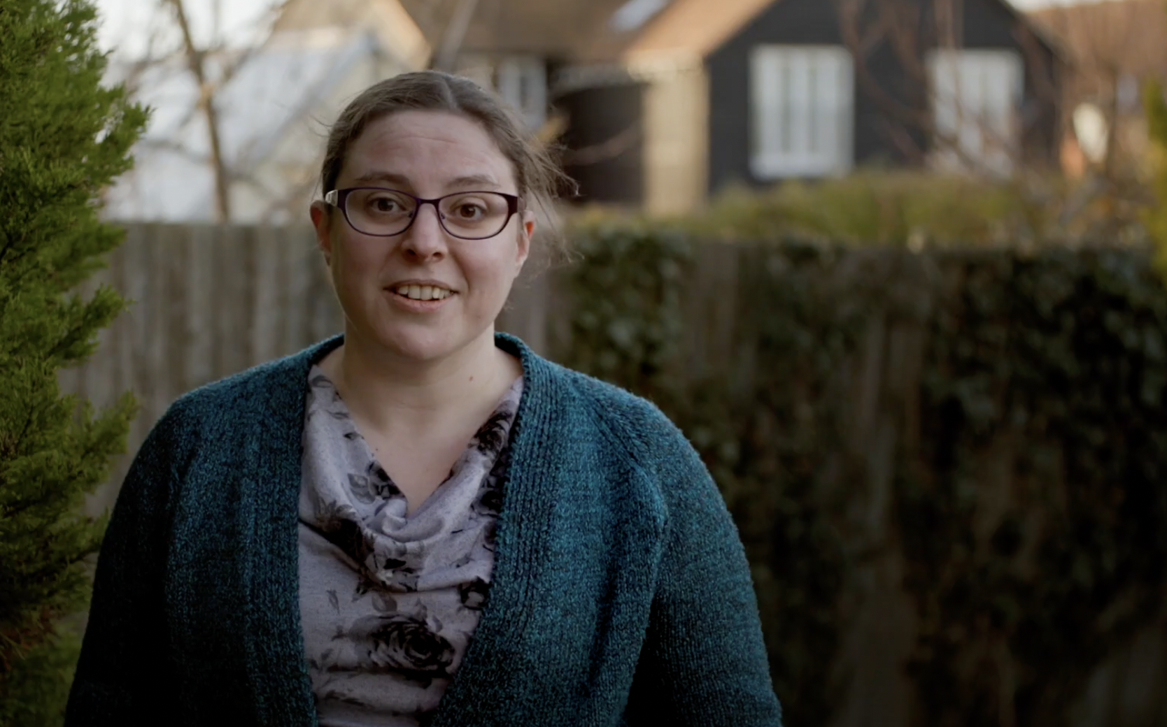
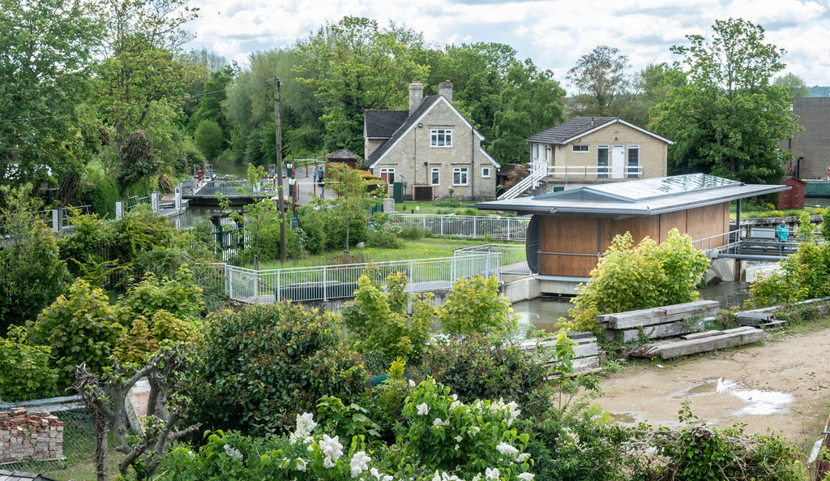
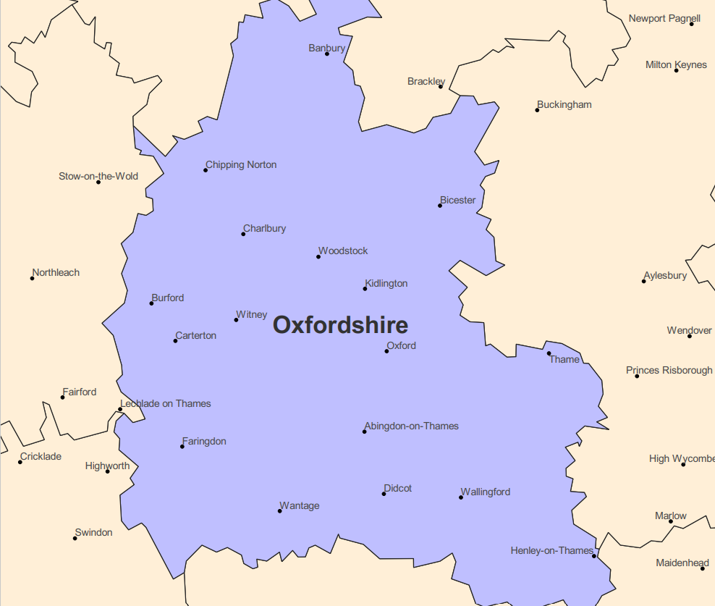
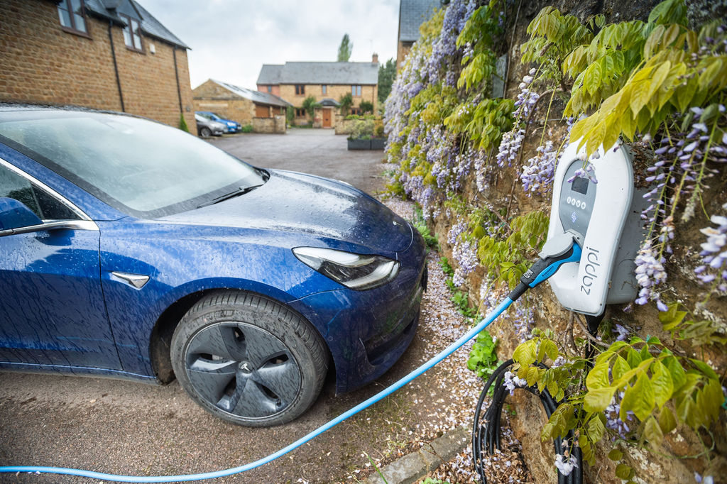
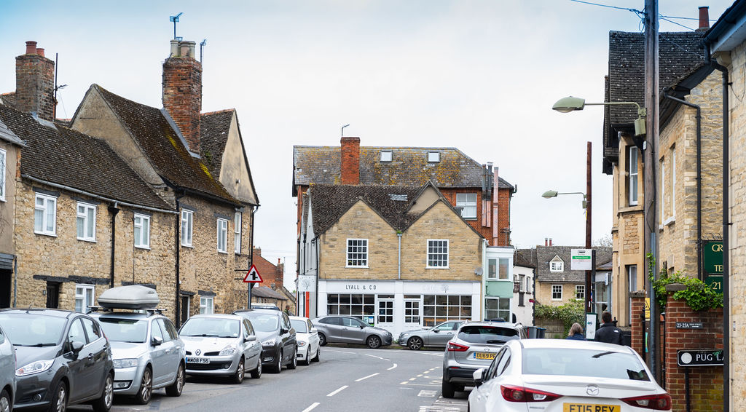
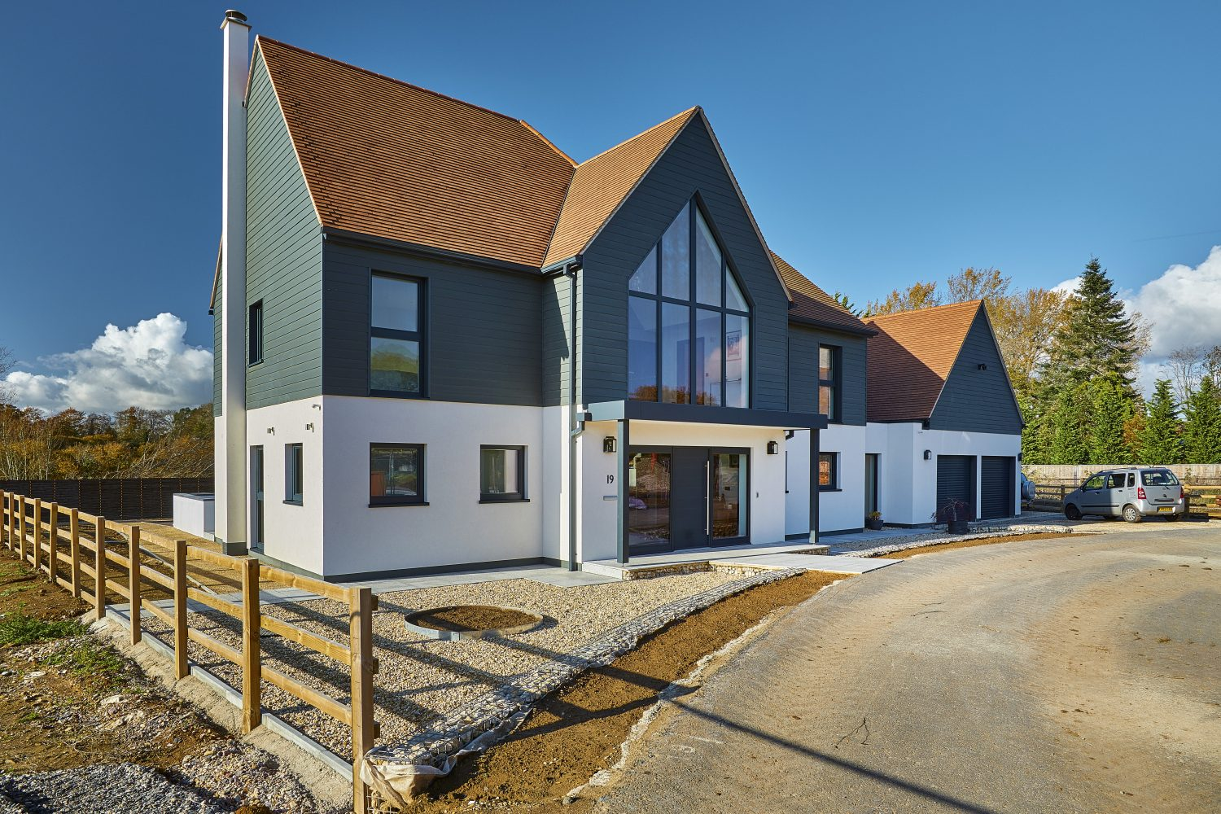
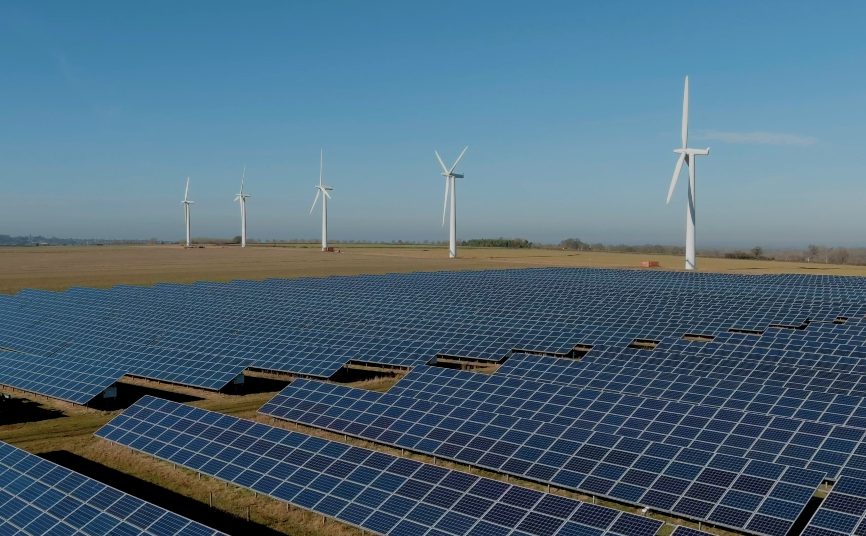
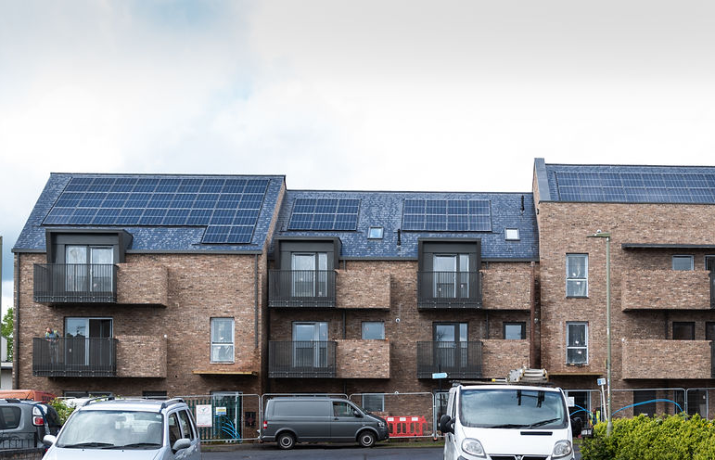
Smart & Fair Neighbourhood Trials
‘The future of the low carbon economy has arrived. Participating in trials like this means being part of that future.’
Sarah
Community trial participant
Notes:
Communities have also been at the heart of our innovation work.
The six Smart and Fair Neighbourhood trials for Project LEO were all about involving communities in the sustainable energy system of the future. We learnt how the opportunities from the transition to a smarter, more flexible electricity system can be maximised and unlocked, and how households, businesses, and
communities can realise the benefits.
To fully unlock the potential benefits of flexibility at the grid edge, mass participation is needed. This in turn requires tailored opportunities to meet the interests and needs of different individuals, organisations and communities.
Through the Smart and Fair Neighbourhood trials (SFNs) we have been testing different approaches to delivering flex – and each was made possible because of the incredible support of local groups and communities. And want to take this opportunity to thank them all for their support.
Background:
A summary of each trial can be found here: https://www.lowcarbonhub.org/projects/case-studies/?type=&project-type=&project-category=project-leo&sort=date
And here’s the SFN video https://youtu.be/XwaEOyYs2Us?si=2dwcvN870I9mP9AI

Slide 26
CREATING ENERGY WE CAN ALL FEEL GOOD ABOUT
www.lowcarbonhub.org
CREATING ENERGY WE CAN ALL FEEL GOOD ABOUT
Treasurer’s Report
Luke Marion, Treasurer

Slide 27
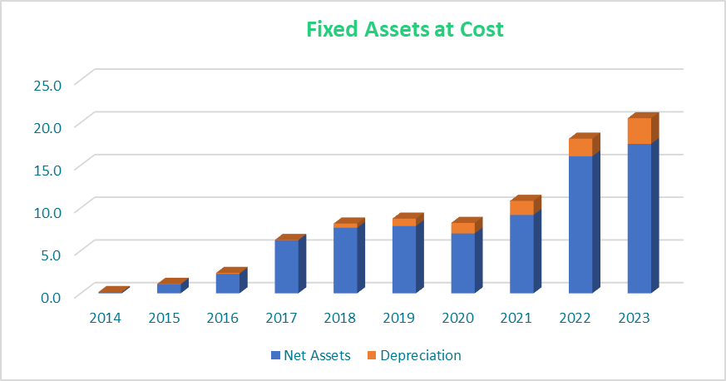
Asset Base
Fixed asset value has now grown to £17.5m – cost £20.5m, depreciation to date £3.0m).
£4.4m capital expenditure in the year.
  - £3.68m for RVS construction.
  - £358k for Norbar 2.
  - £166k for ACRO.
  - £109k For Osney Super Hub.
  - £84k Inverters for PPS2.0.

Slide 28
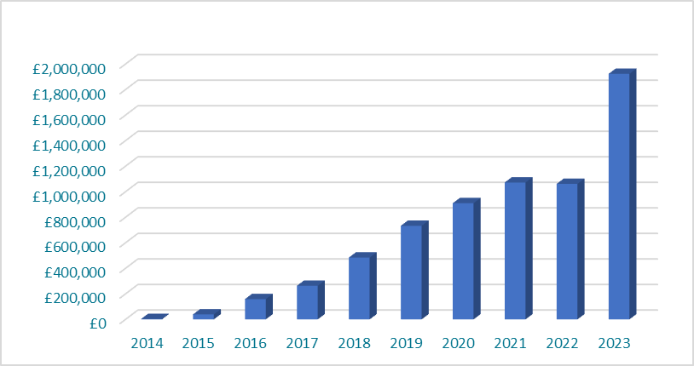
Income
Turnover for the year has increased by £861k.
Assisted by the final year of grant income from Project LEO - £572k [2022: £248k]. LEO grants that ceased on 31 March 2023.
The IPS Group have £4.8m of LEO Grant Capital Project balances that will recognizing Deferred Revenue over the lifetime of the projects. £138k per year for next ten years will be released to the Profit and Loss account.
RVS electricity generation since 23 August 2022 to 31 March 2023 was £554k.
Hot summer solar offset by low river levels on SHL.

Slide 29
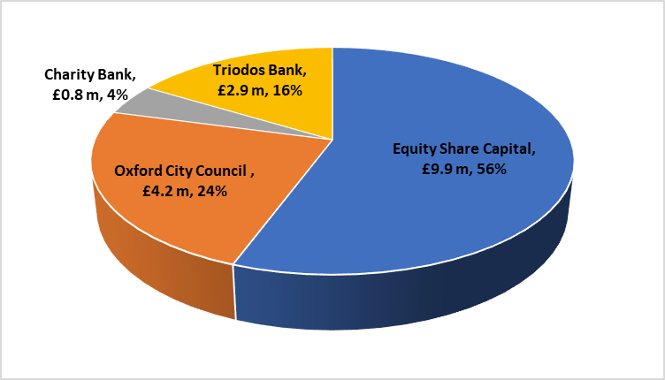
How is the IPS funded?
As at year end – total £17.8m capital
No new share raises in the year.
Share equity fell by £153k due to annual repayment of share capital.
Charity bank long term debt reduced by £719k in year. Total remaining Loan Balance £805k.
Oxford City Council forwarded £4.1m long term loans for RVS in the year, providing £4.2m at the year end.
£2.9m loans facility with Triodos Bank was drawn down for RVS construction with agreement in place to convert to long term operational debt.
Equity share capital £8.4m

Slide 30
OUR FUNDING POLICY
Aim over time to eliminate all debt (other than long term project debt).
New debt or bonds if required should be at less than we pay to shareholders.
The debt-to-equity ratio should not be more than 50:50.

Slide 31
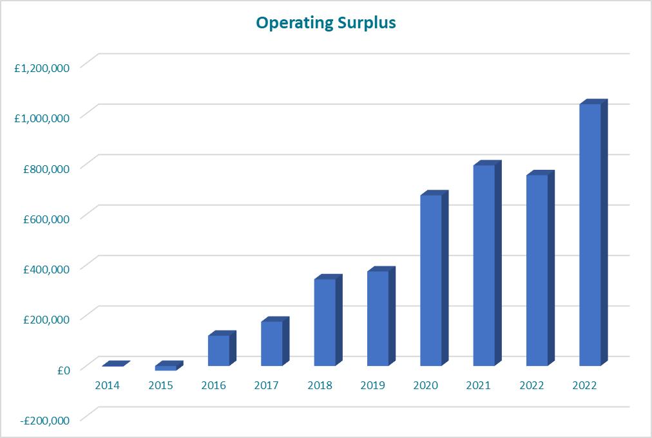
Building our scale - Operating Surplus
Operating surplus was £1,038k [2022: £756k].
Surpluses used to pay interest to debt providers and investors, and to fund community benefit.
We record accounting losses due to depreciation on our installations, and we return capital to members during the lifetime of the invested assets.

Slide 32
QUESTIONS ON THE ACCOUNTS?

Slide 33
CREATING ENERGY WE CAN ALL FEEL GOOD ABOUT
www.lowcarbonhub.org
Looking Forward
CREATING ENERGY WE CAN ALL FEEL GOOD ABOUT
Dr Barbara Hammond MBE, CEO &
Steve Drummond, Chair

Slide 34
QUESTIONS?

Slide 35
CREATING ENERGY WE CAN ALL FEEL GOOD ABOUT
www.lowcarbonhub.org
CREATING ENERGY WE CAN ALL FEEL GOOD ABOUT
Formal AGM resolutions

Slide 36
Annual General Meeting
Low Carbon Hub IPS Limited
Members of Low Carbon Hub IPS Limited are entitled to vote at this AGM.
You are a member if you have invested money and so hold shares in any of the following portfolios:
            Solar 2014
            Solar 2016
            Sandford Hydro
            ONCORE A
            ONCORE B
            Community Energy Fund
Community groups who have recently completed the share exchange process hold a £1 share in the Community Energy Fund. Each group is entitled to a vote. This should be cast by your group's Authorised Representative.

Slide 37
Annual General Meeting:
How to vote
Voting at the AGM uses Zoom’s poll functionality. We will read out the motions and ask you to cast your vote.
On screen you will see option to vote For, Against, or Abstain. Please select one option and press submit.
There is also an option to let us know that you have already let us know your voting choice using the proxy form in advance.
Formal results will be published on our website; however, we will take an indicative result on the night from the live poll.
Low Carbon Hub IPS Limited

Slide 38
Low Carbon Hub IPS Limited: Agenda
Minutes of last meeting
Directors' report
Accounts and auditor's report
Appointment of auditors
Board Remuneration
Election of directors

Slide 39
Low Carbon Hub IPS Limited AGM
1. Minutes of last meeting
  Members are asked to approve the minutes of the last AGM
Members will vote on this motion.

Slide 40
Low Carbon Hub IPS Limited AGM
2. Directors' report
  Members are asked to receive the Directors' report for 2022/23
Members receive the report (there is no vote).

Slide 41
Low Carbon Hub IPS Limited AGM
3. Accounts and auditor's report
  Members are asked to approve the accounts and auditor’s report for 2022/23
Members will vote on this motion.

Slide 42
Low Carbon Hub IPS Limited: Agenda
4. Appointment of auditors
  Members are asked to approve the re-appointment of Critchley's as auditors for the coming year
Members will vote on this motion.

Slide 43
Low Carbon Hub IPS Limited: Agenda
5. Board Remuneration
Members are asked to approve the basis of remuneration of the Board
Rule 17.11 states that the society can pay its directors, but only if the members approve the basis for the payments. Members are therefore asked to approve the principle of Non-Executive Directors receiving payment in compensation and recognition of the time and commitment required to be active members of the Board. Remuneration is being proposed on the following basis:
The initial rate should be £5,000 per annum as a material amount that would ensure Board member attendance and focus.
That the Chair should receive between 1.5 and 2.5 times the rate for other Non-Executive Directors, at discretion of the Board. This is to allow some responsiveness to candidate quality and the needs of the organisation at any particular time.
That this rate will be reviewed annually, and may be increased in line with any salary increase agreed for Low Carbon Hub staff.
Members will vote on this motion.

Slide 44
Low Carbon Hub IPS Limited AGM
6. Election of directors: part one
  Members are asked to re-elect Steve Drummond as Non-Executive director
  Members are asked to elect Mairi Brookes as a director
  Members are asked to elect Maxine Frerk as a Non-Executive director
  Members are asked to elect Saskya Huggins as a director
  Members are asked to elect Tim Jones as a director

Slide 45
Low Carbon Hub IPS Limited AGM
6. Election of directors: part two
  Members are asked to elect Robert Kesterton as a Non-Executive director
  Members are asked to elect Al Kitchen as Non-Executive director
  Members are asked to elect Chukwuemeka Godwin Nwangele as a Non-Executive director
  Members are asked to elect Lenah Oduor as a Non-Executive director
  Members are asked to elect Mish Tullar as Non-Executive director
  Members are asked to elect Chris Woolhouse as Non-Executive director

Slide 46
CREATING ENERGY WE CAN ALL FEEL GOOD ABOUT
www.lowcarbonhub.org
CREATING ENERGY WE CAN ALL FEEL GOOD ABOUT
Closing
Remarks

Slide 47
CREATING ENERGY WE CAN ALL FEEL GOOD ABOUT
www.lowcarbonhub.org
CREATING ENERGY WE CAN ALL FEEL GOOD ABOUT
THANK YOU FOR JOINING US!

