Slide 1
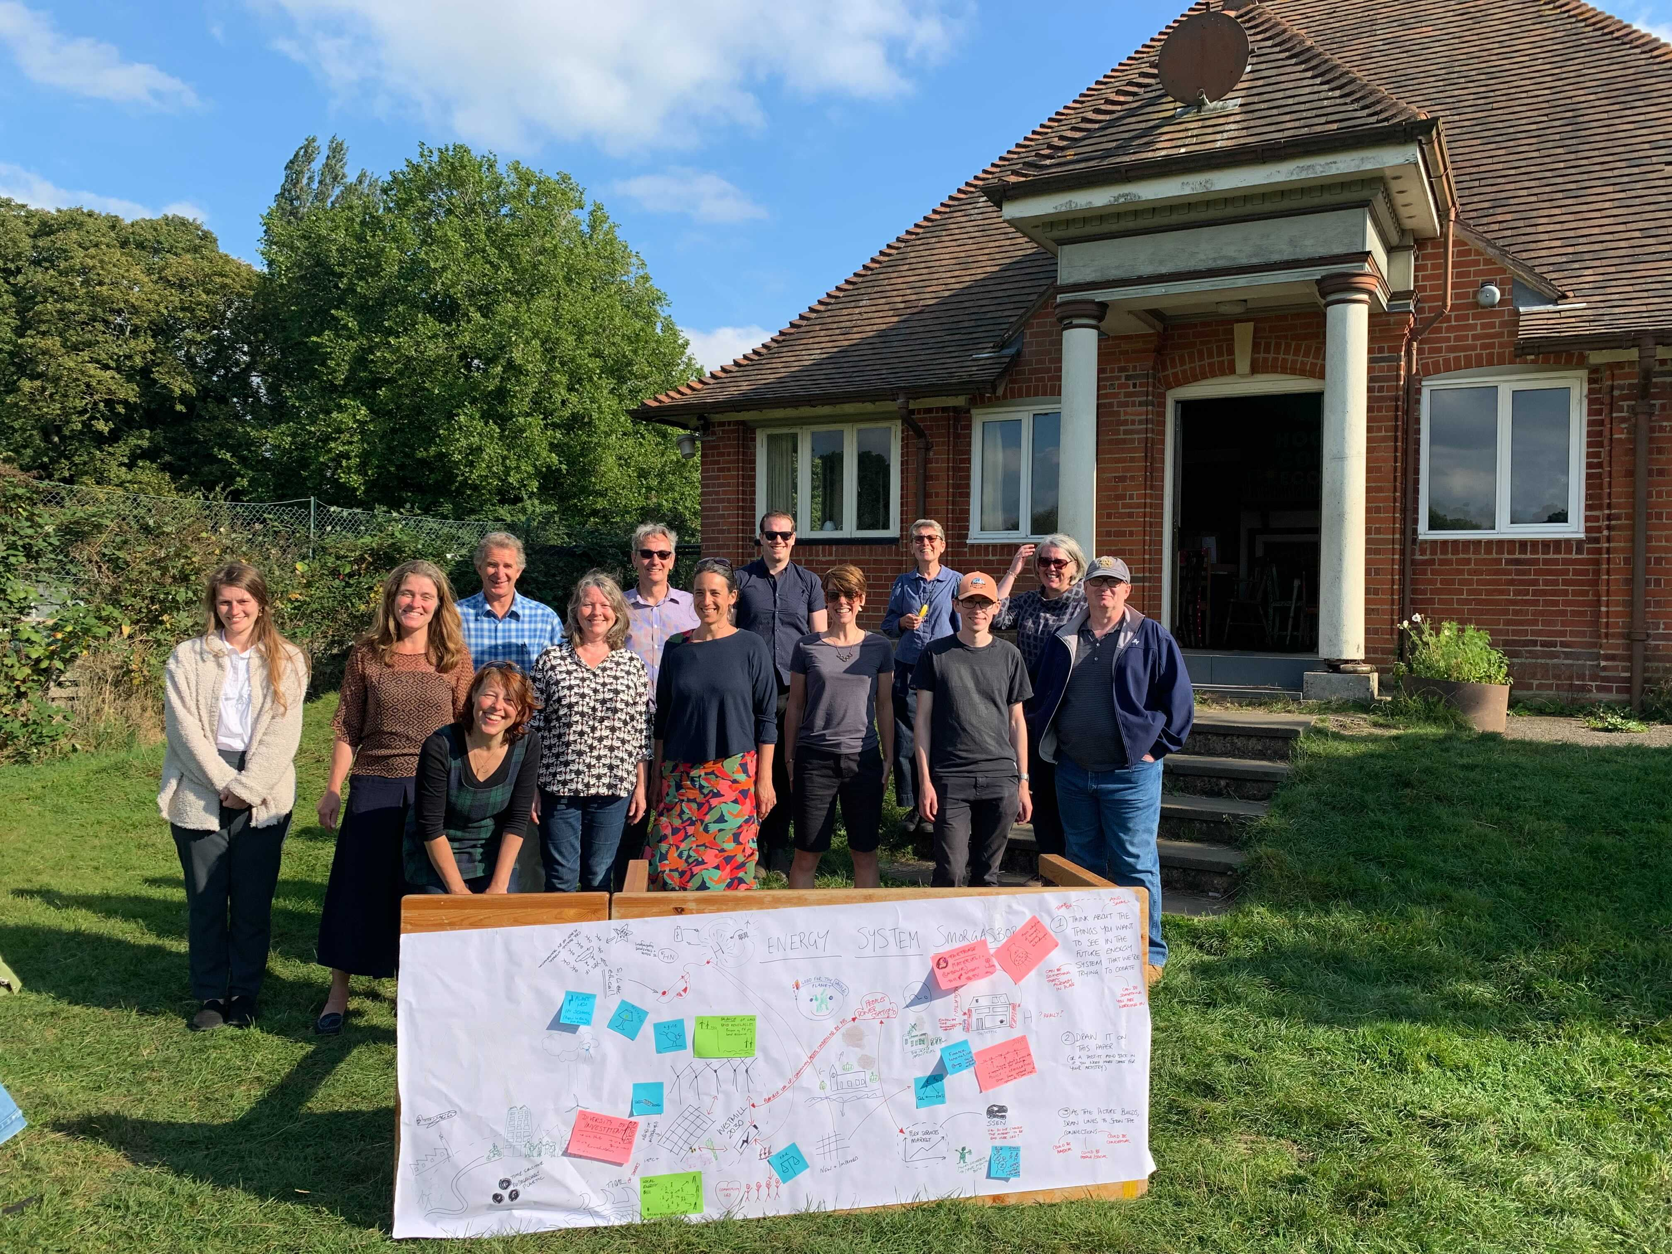

Low Carbon Hub
Big Community Autumn
Get Together 2023
NEW SECTION HEADING
[Insert new section heading]

Slide 2


CREATING ENERGY WE CAN ALL FEEL GOOD ABOUT
www.lowcarbonhub.org
CREATING ENERGY WE CAN ALL FEEL GOOD ABOUT
Support for communities

Slide 3

Low Carbon Communities

Slide 4

Community Grants Programme
Supporting community energy activities across Oxfordshire that contribute to the creation of a decentralised and locally owned renewable energy system.
‘powering up’: increasing renewable heat or electricity generation
‘powering down’: improved energy efficiency in homes and buildings
supporting the shift to a low carbon transport system.
Small grants up to £500 – apply any time before 14 February 2024
Large grants up to £5,000 – single competitive round apply by 19 January 2024
Only Low Carbon Hub community group network members can apply
Notes:
is this taking too much credit for groups' work? 'Our low carbon community group members are at the heart of our work to transform the energy system.'
Perhaps 'Our vibrant community groups are at the heart of the Low Carbon Hub. It is our collaboration with them that continues to inspire and inform what we do.' or something like it?

Slide 5
Networking and training
As a member of our network you also get to participate in all our events and training.
18 October Thermal Imaging Training workshop 6pm
3 November Energy Champion Training
29 November Low Carbon Transport
Regular community group meetings
Notes:
is this taking too much credit for groups' work? 'Our low carbon community group members are at the heart of our work to transform the energy system.'
Perhaps 'Our vibrant community groups are at the heart of the Low Carbon Hub. It is our collaboration with them that continues to inspire and inform what we do.' or something like it?

Slide 6

Energy Assessments
Notes:
https://www.lowcarbonhub.org/p/programmes/energy-solutions-oxfordshire/

Slide 7



Energy Solutions Oxfordshire
Tailored energy assessment plans that give organisations everything they need to cut energy waste and start their net-zero journey.
Based on energy use analysis and on-site visits, and delivered by trusted experts, it includes:
analysis of current energy use
a costed improvement plan
low/no cost options
identifies where you waste energy
highlights equipment and fabric improvements
shows how to run your buildings more efficiently
Notes:
Energy Solutions Oxfordshire (ESOx) is a partnership between the Low Carbon Hub and Oxford Brookes University’s Environmental Information Exchange (EIE).
The service offers consultancy, reports and project management for businesses wanting to reduce their carbon emissions, save on energy bills and make their work environment more comfortable.
The team is made up of experts with decades of combined experience working with Oxfordshire businesses to deliver tailored energy improvements for their premises.
We can work with businesses and organisations of any type or size.
Assessment – on site visit and assessment report which includes costs and savings (starting at £1,500) - implementation report, a detailed breakdown of costs and payback
Invest stage – The team can assist with finding finance to implement your measures (this would have an extra cost)
Install - Implementation and project management– support provided to oversee implementation to reduce the impact on the business during work and installation

Slide 8


Who is this service for?
Any business, educational or academic institution, community organisations or charities - in short, any non-domestic workplace in Oxfordshire
We offer a free downloadable Workplace Energy Efficiency Checklist, which gives advice on how they can implement some quick-win measures to get started on their journey.
Notes:
Best suited for:
Organisations in Oxfordshire that are actively looking to improve the energy performance of their buildings. They are actively looking to carry out work, have a major refurbishment planned or are moving office in the near future (rather than being in early exploratory phase.) They anticipate carrying out multiple measures at once, probably renewables plus at least one energy efficiency measure.
Owner occupied, or long lease to match payback (7-10 years min)
To note: On average, organisations reduce their energy bills by 19% per year when they implement the advice outlined in the ESOx assessments.

Slide 9
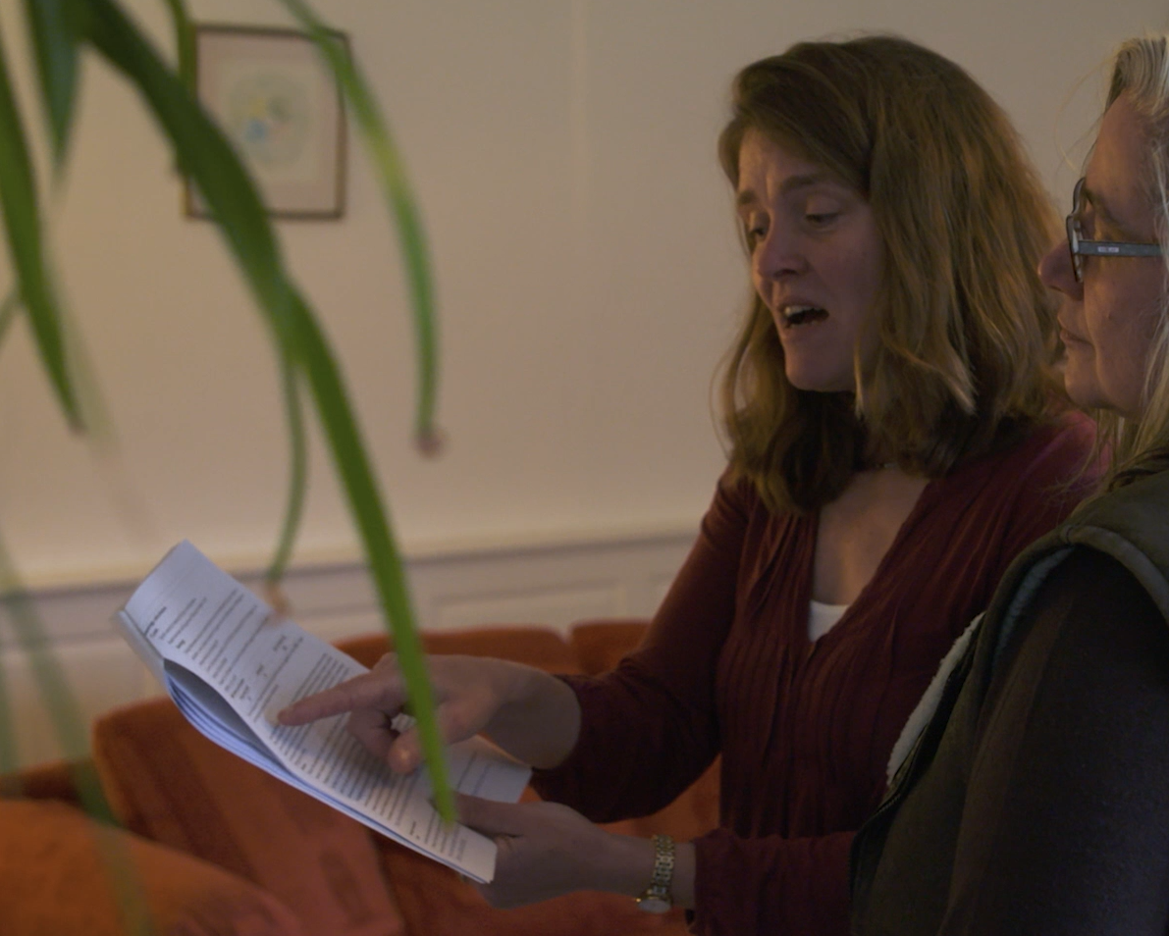
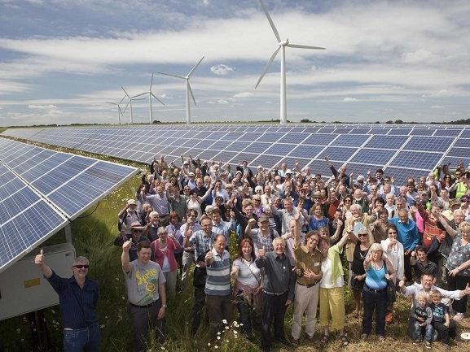

Community buildings
Notes:
Nominate a building in Oxfordshire via lowcarbonhub.org

Slide 10
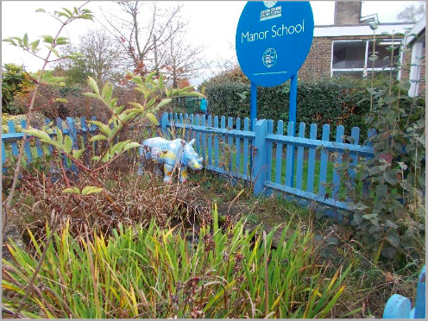
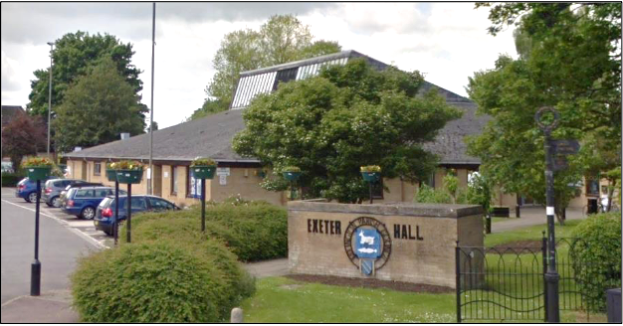
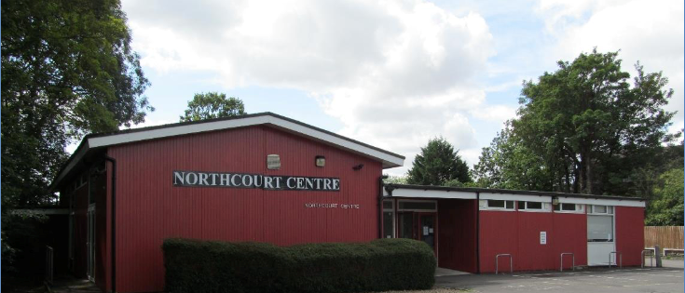
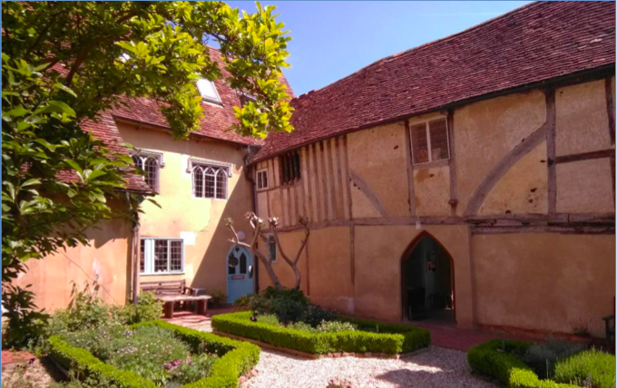
Who can benefit?
Any community building in Oxfordshire or within 25 miles of Westmill Solar Park
Organisations are likely to be at an early stage of exploration into improving their energy performance
Or you may be planning a new build and would like feedback on architectural plans for new facilities
The workplace energy efficiency checklist can help get them started
Community buildings checklist on our website with additional advice, including
funding options
Notes:
Who eligible?
Organisation: Any community building, including a village hall, school, sports pavilion, youth club, community centre, church or other faith building that may benefit from energy savings.
Building owner: As above. We will consider applications from buildings owned by Local Authorities and Parish Councils, so long as a significant part of the building is used regularly for community activities.
Location: Oxfordshire (for the Low Carbon Hub Community Buildings Audit Programme) or
Within 25 miles of Westmill Solar Park (for the WSC Community Buildings Audit Programme)

Slide 11

Schools

Slide 12

Action on Carbon and Energy in Schools
Action on Carbon and Energy in Schools (ACES) is an energy efficiency support service to help schools in Oxfordshire carry out energy saving measures to:
Cut carbon emissions
Save money on energy bills
Make buildings more comfortable and healthier for staff and students
Notes:
https://www.lowcarbonhub.org/our-services/for-schools/

Slide 13

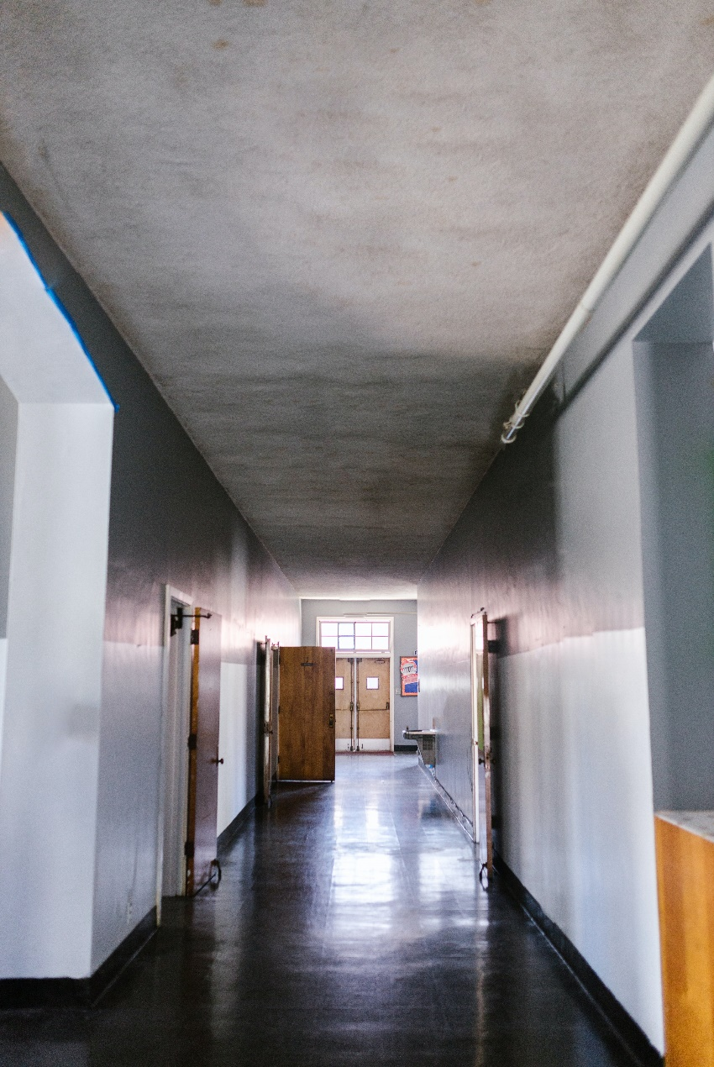
Improving schools energy efficiency
  Free energy efficiency support to schools in Oxfordshire
  Free energy assessments to assess the changes that would benefit your buildings
  One-to-one support in creating bespoke energy efficiency plans for your school
  Access to webinars, workshops, and other events to help you
  Funding to cover simple measures such as boiler room insulation
Notes:
James

Slide 14

Host a Low Carbon Hub solar PV array

Slide 15
Host a Low Carbon Hub-owned solar array
  How does it work:
  We own the solar panels, leasing roof space from our host organisations (e.g. schools, businesses, community halls)
  We raise the capital to pay for the kit and installation
  We manage and maintain the array throughout its lifetime
  The host organisations buy the energy they need from the panels, and any excess is sold to the National Grid
  We reinvest 100% of our own surplus revenue (after costs and investor returns) in carbon-cutting community activity

Slide 16
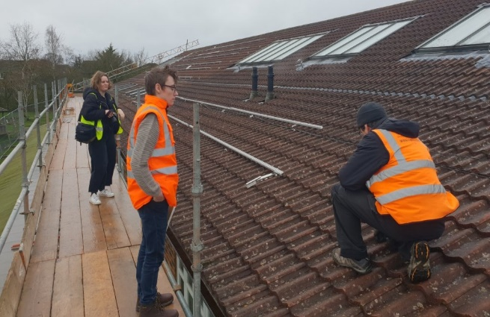



A potential site will be…
250 m² minimum roof size
50 kW minimum installed capacity
Building has significant day-time energy use
Not north-facing
Good roof condition
Owner-occupied or 10+ year lease
Organisation is interested in hosting a Low Carbon Hub installation
Notes:
These are the projects we are looking for:
250 m² minimum roof size
50 kW minimum installed capacity
The building has significant day-time energy use
Not North-facing
Good roof condition
Owner-occupied or 10+ year lease
Organisation is interested in hosting a Low Carbon Hub installation
https://youtu.be/5JP0IeOwIWQ via https://www.lowcarbonhub.org/host-a-solar-pv-array/

Slide 17

Case study:
Thames Travel
Project commissioned September 2019
175 solar panels installed
50 kWp installed capacity
44,303 kWh of renewable energy generated per year
Could power 15 typical homes per year
Notes:
www has slightly different figure of annual generation: https://www.lowcarbonhub.org/p/projects/thames-travel/
‘•Could power 15 typical homes' - for how long? – perhaps replace with 29% of company’s electricity needs met? (www)

Slide 18

Potential ground mount
Minimum 20 acres
> 5 MW array
Not grade 1 or 2 agricultural land
Owner interested in hosting an installation for 30+ years
Smaller arrays (5 acres, 1MW) may be possible if the site can be linked via private wire to a nearby customer with high annual electricity bills (£150,000+p.a.)
Notes:
James

Slide 19
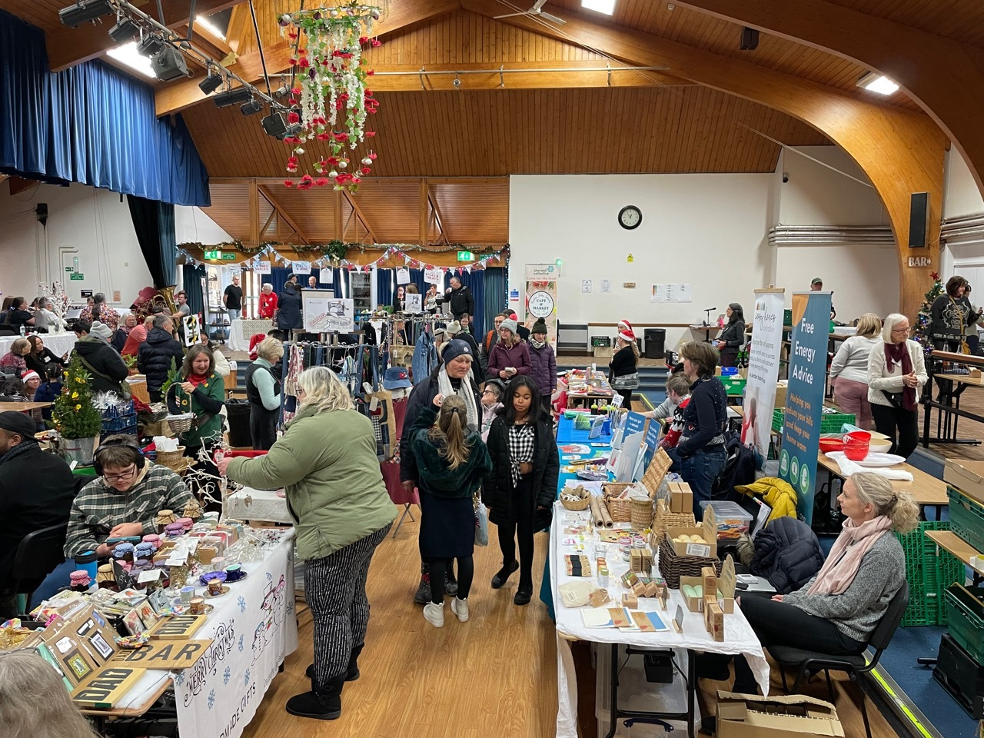
Householders

Slide 20
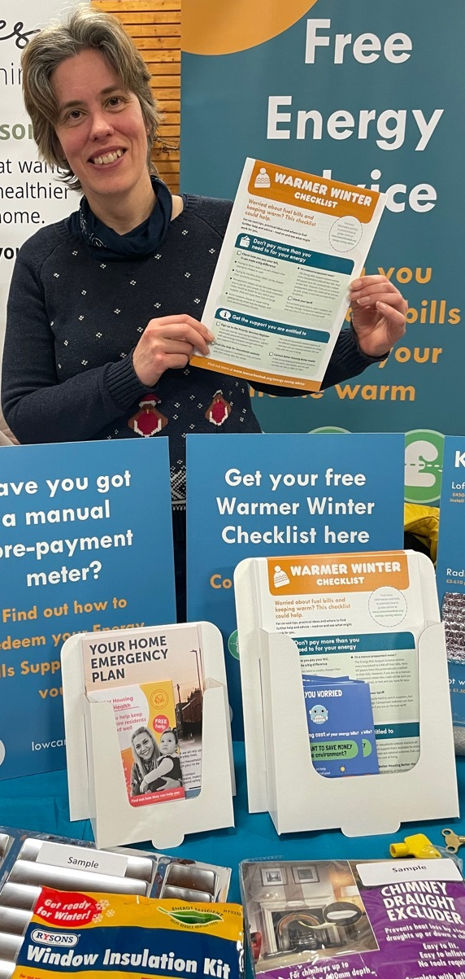
Energy Advice Programme
Comprehensive online advice on our website
Warmer Winter Checklist
Volunteer Energy Champions and two energy advisers
Energy Advice stall in a box
Free Energy Champion training day Friday 3 November
Notes:
www has slightly different figure of annual generation: https://www.lowcarbonhub.org/p/projects/thames-travel/
‘•Could power 15 typical homes' - for how long? – perhaps replace with 29% of company’s electricity needs met? (www)

Slide 21
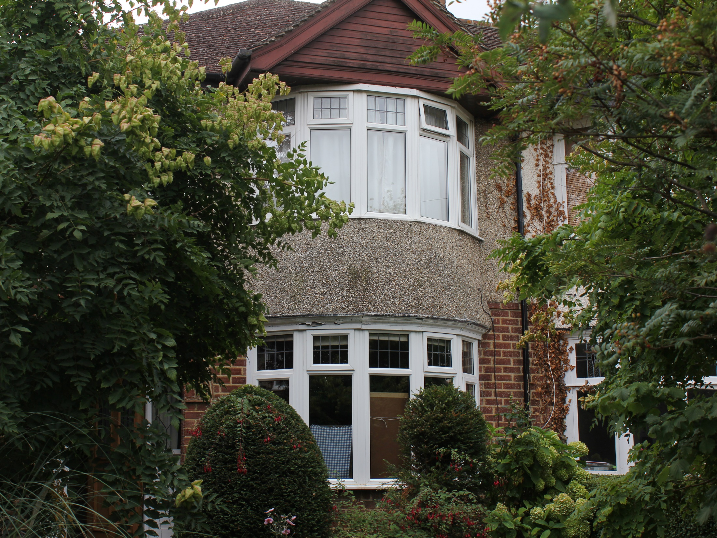
Cosy Homes Oxfordshire
Notes:
Cosy Homes Oxfordshire is a local home retrofit service, that makes homes greener, cosier, and cheaper to run.
Partners Low Carbon Hub and RetrofitWorks are continuing the project now BEIS (UK Department of Business, Energy, and Industrial Strategy) funding ended in March 2021.
Attempting a retrofit project is complex and involves huge amounts of time researching and project managing.
Cosy Homes Oxfordshire offers a combination of expertise, experience, and access to approved contractors as an overall project manager for retrofits.
They see a project through from start to finish providing key aspects and making the process simpler for residents.
Making improvements makes homes healthier and more comfortable – removing damp build up and draughts.

Slide 22

Cosy Homes Oxfordshire
Plan Builder
Get started with a plan for free
Whole House Plan
An in-depth personalised report on your home and energy use
Retrofit Coordinator
A skilled expert who will help guide you in your decisions, resolve problems, and guide homeowners through the build process
Notes:
Home assessment & Whole House Plan – visit to assess your whole house to find out everything we need to know about your existing energy usage and the building itself recommendations on the most cost-effective and impactful measures to take forward, and in what order (starting at £250)
Client Service Agreement – outlines any additional costs before work can begin on your retrofit project; brings together building performance requirements, technical reports, and architectural drawings (£500–1,500)
Project management – gathering quotes from a pool of approved contractors; Retrofit Coordinator checks on work and reports to resident; quality assessment is carried out to check the work is completed to specification (5% from overall project above £10,000 – with an average project typically around £25,000)

Slide 23
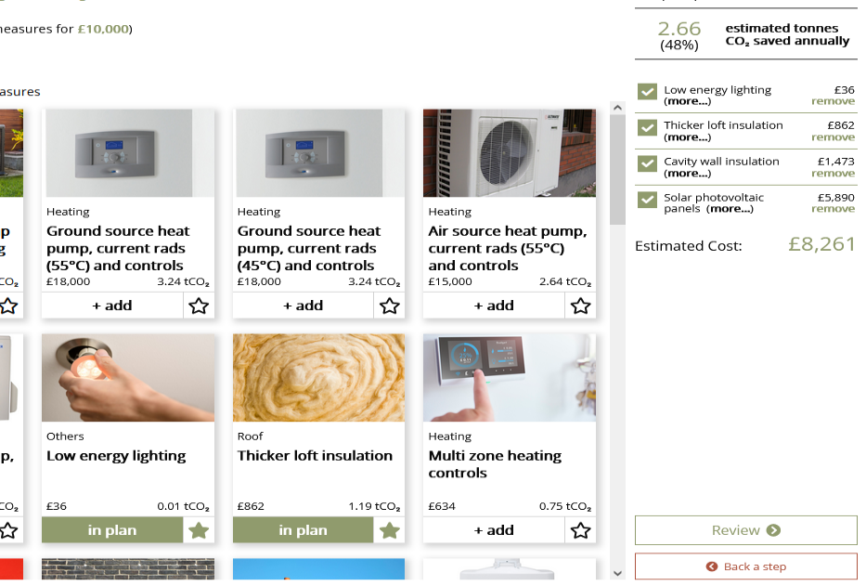

Plan Builder
Free online tool - giving Oxfordshire residents an idea of possible energy efficiency measures for their home, based on existing data about their address and housing type
Estimates energy, cost, and carbon savings as well as project costs
If user is happy with plan, they submit it, and Cosy Homes gets in touch to discuss details
Notes:
Put in your postcode
you’ll see everything known about the current energy efficiency of your home based on existing data
Put in your budget and priorities
The plan builder gives a draft retrofit plan for your home which you can edit – e.g. loft insulation, air source heat pump, double glazing
If you submit your plan, the Cosy Homes Oxfordshire team will get in touch and suggest different routes to progress – which could be booking you in for a home assessment.
It’s a great place to start and get an idea about what you could do to upgrade your home, start building a plan.

Slide 24
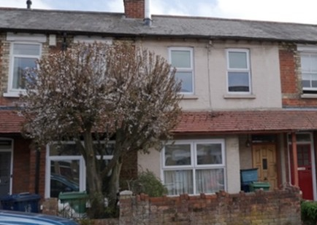

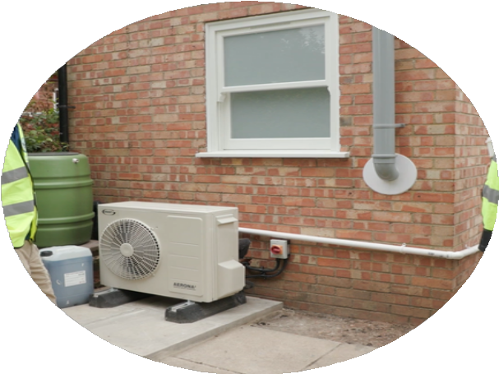
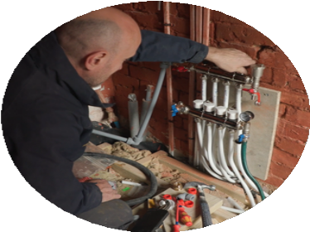
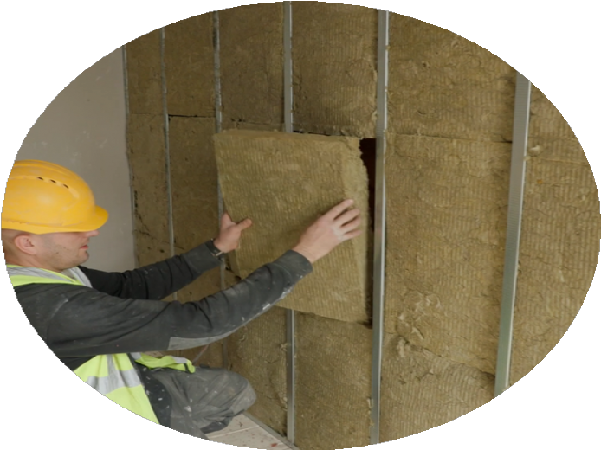
Case study:
East Oxford terrace
House: late 1800s terrace with solid brick walls
Lis and Sarah were very conscious of the environment, and cutting carbon emissions was the main aim of their retrofit
Measures:
2 kWp solar PV array
Traditional timber sash windows with double glazing
Air source heat pump
Internal wall wood fibre insulation (IWI)
Cavity Wall Insulation (CWI)
Loft insulation on the main roof with a controlled ventilation system
Flat roof insulation on the backroom extension
Underfloor heating and insulated floors
Savings:
59% estimated savings on energy bills, 68% reduction in CO₂ emissions: 3.39 tonnes of CO₂e are saved every year
Notes:
Figures are based on Whole House Plan estimates when the home was assessed.

Slide 25
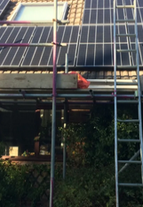
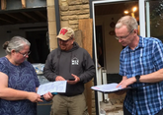
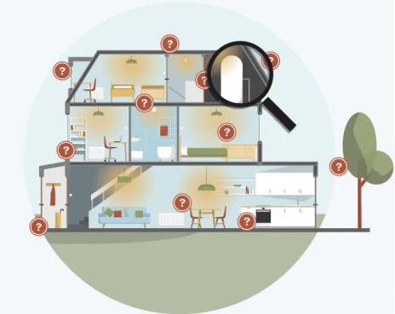
Who is this service for?
Homeowners who want to reduce their energy bills, cut carbon emissions, and have more comfortable home
Residents with older or more complex homes benefit greatly from our ‘Whole House Plan’
Those in the ‘able-to-pay market’ who are ready to start installing energy saving measures, with an overall estimated cost above £20,000
Notes:
James

Slide 26
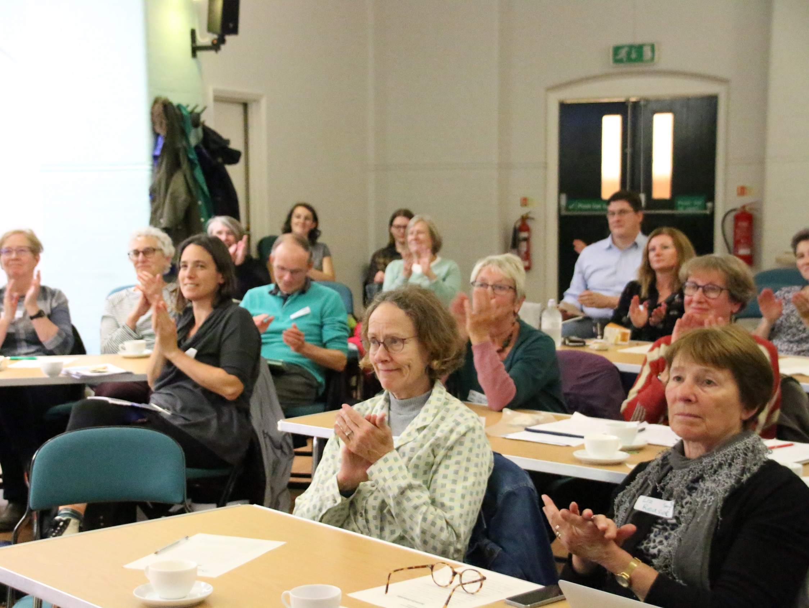
Other support

Slide 27
Other support to consider
Oxford Church Buildings
  Oxford Diocese Energy Audits Programme
Community Energy England
  ‘How to’ do community energy
CAG Oxfordshire
  - www.cagoxfordshire.org.uk

Slide 28
CREATING ENERGY WE CAN ALL FEEL GOOD ABOUT
www.lowcarbonhub.org
CREATING ENERGY WE CAN ALL FEEL GOOD ABOUT
Thank you!

